Slide 1



FINAL PROGRESS PRESENTATION
COCOCLARITY
Elevating Efficiency and Sustainability in Large-Scale Coconut Oil Manufacturing through Progressive Strategies
Project ID : R24-059
10/27/2024
1

Slide 2





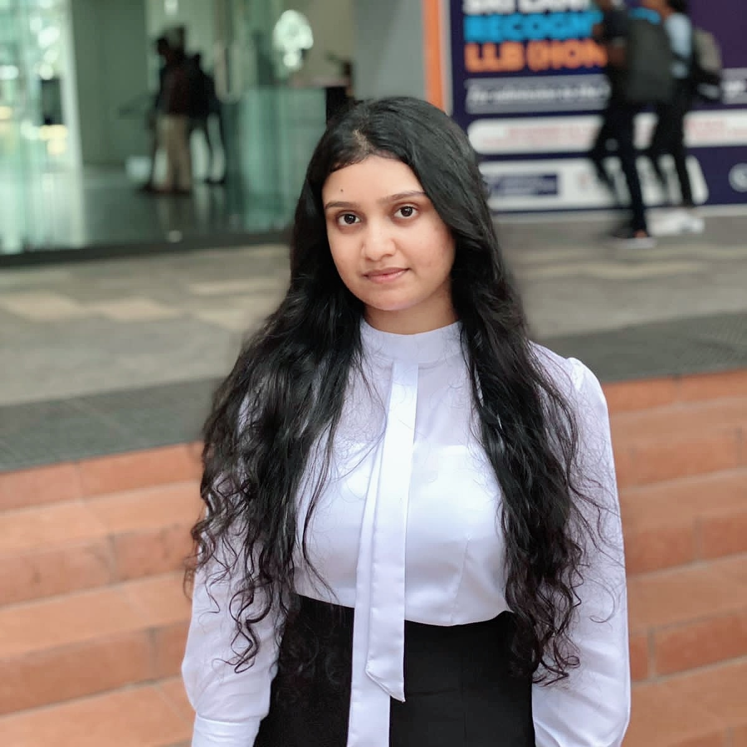

OUR TEAM
MR. NELUM AMARASENA
MS.MANORI GAMAGE
DR. Chandi Yalegama
(Head, Coconut Processing Research Division)
WELIGAMA D.M.P.D
DEWMINI A.M
BANDARA A.M.S.S
FERNANDO W.P.A.M

Slide 3
AGENDA
Introduction 4
Problem Statement 5
Research Problem 6
Objectives 7
System Overview Diagram 10
Individual Components 8
Requirements 5
Commercialization 9
Supervisor Meetings 12

Slide 4
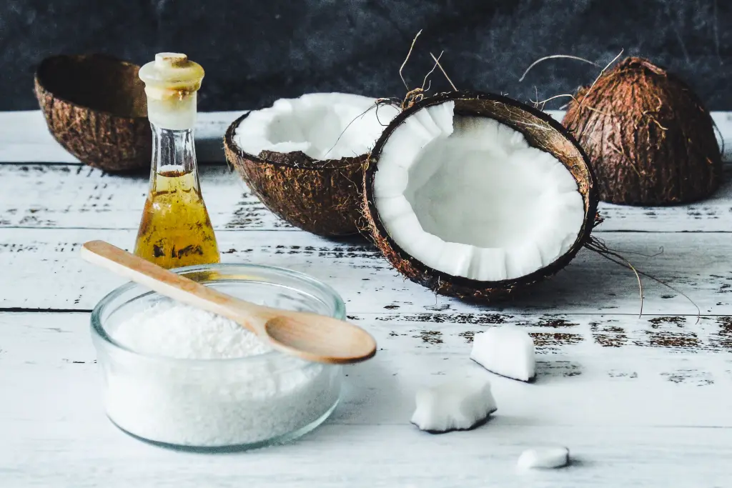


INTRODUCTION
4th largest coconut producer.
7th largest coconut oil producer.
Sri Lanka is a country rich in coconut trees
There are many ways that we can apply to Sri Lanka's coconut oil industry to increase the productivity.

Slide 5

RESEARCH PROBLEM
How to apply fast-changing AI/ML to increase sustainability and efficiency in the coconut oil industry?
Support coconut oil manufacturers to choose which oil type to be manufactured?
How much of coconut oil will be required in the future through past insights?
Provide fast coconut oil quality predicting system through smartphone with high accuracy lab test?
Provide marketing features such as finding out which countries to export to and what percentage?

Slide 6

Objectives of the Study
To build a web application and mobile application to apply AI/ML technology to coconut oil industry.
Our system,
Recommends the best coconut oil to be manufactured through the nature of the copra.
Analyses past coconut oil yields and predict future coconut oil yields.
Predicts coconut oil quality and make sure them with lab results.
Analyses the changes in the world and predict the coconut oil demand by country.
10/27/2024

Slide 7
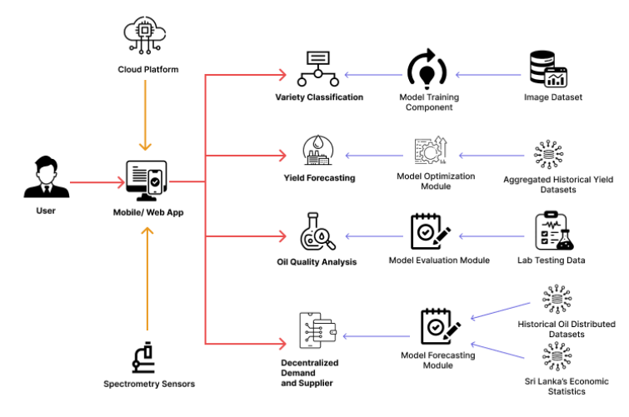
SYSTEM DIAGRAM

Slide 8
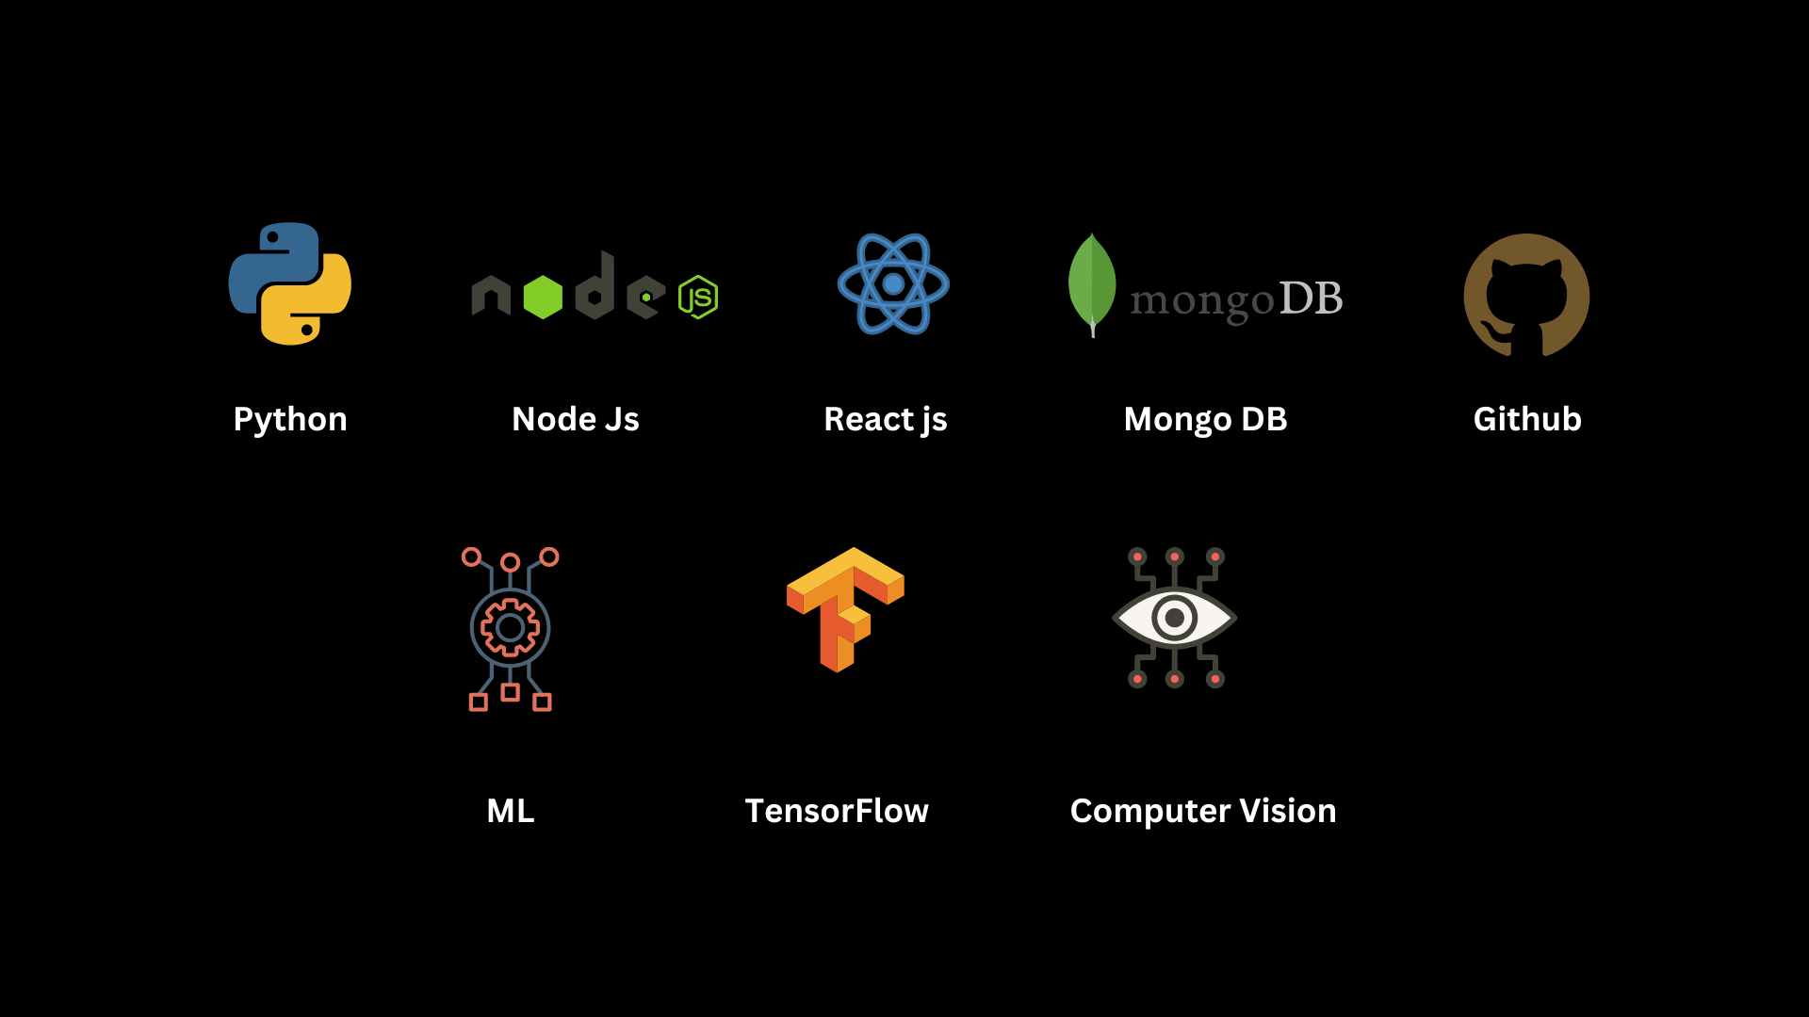

TECHNOLOGIES

Slide 9


IT21061066 | WELIGAMA D.M.P.D
IT Specialization
Copra Quality Prediction
IT21061066 | WELIGAMA D.M.P.D | RP-059
10/27/2024 8

Slide 10
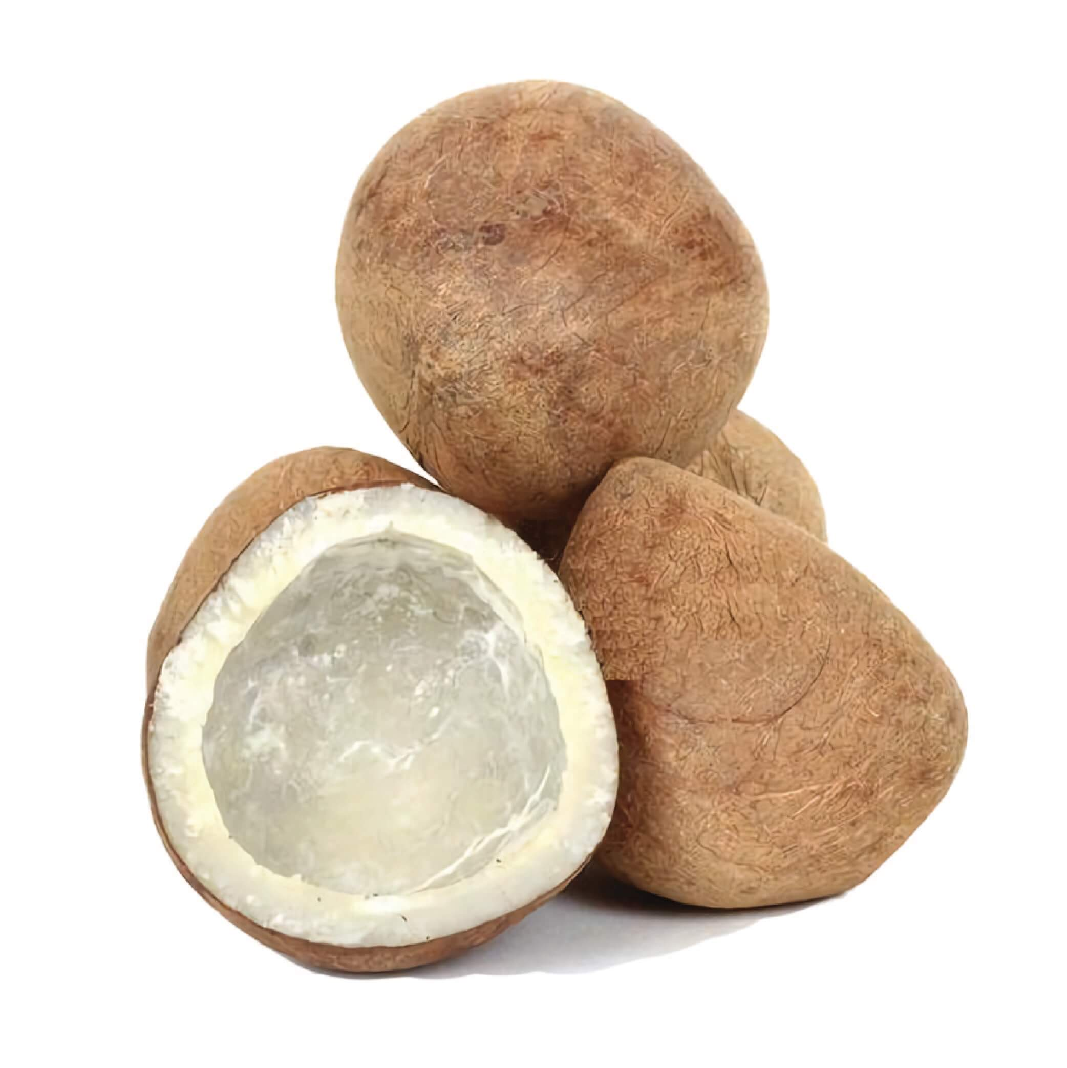
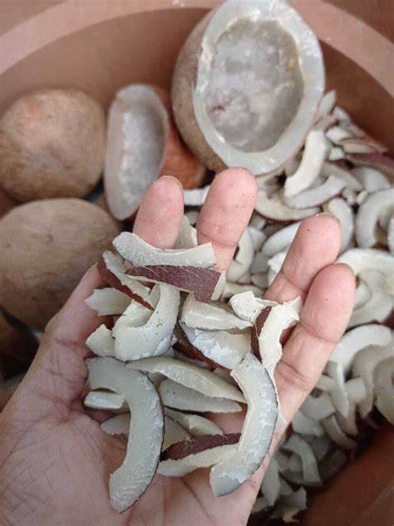
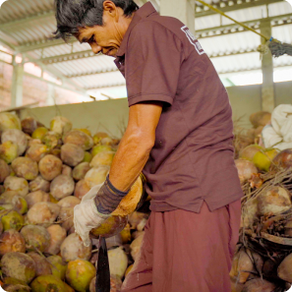
Background of the Study
What is the importance of accurate coconut variety(copra) identification for large-scale coconut oil producers?
What are the challenges with manual or traditional methods of copra identification?
How could technology like deep learning enhance copra identification and recommendations?
IT21061066 | WELIGAMA D.M.P.D | RP-059

Slide 11


RESEARCH PROBLEM
Limited technology adoption restricts productivity gains?
Imprecise manual identification causes output variability?
Underutilization of available variety data patterns?
Lack of tailored recommendations for large-scale producers?
IT21061066 | WELIGAMA D.M.P.D | RP-059
10/27/2024

Slide 12
Research Gap of the Study
Insufficient datasets of local coconut varieties
RGB-Infrared fusion unexplored for better identification
Graph neural networks unused to model variety relations
Tensor factorization absent in feature extraction
Explainability of predictions needs enhancement
Linking visual markers to environment lacking
Optimizing models for edge devices unaddressed
IT21061066 | WELIGAMA D.M.P.D | RP-059

Slide 13

Objectives of the Study
MAIN OBJECTIVES
Empower large-scale coconut oil producers to enhance productivity and product quality through accurate coconut variety identification and data-driven recommendations.
SUB OBJECTIVES
Leveraging transfer learning for variety prediction
Harnessing multi-modal data for robust outputs
Sustaining performance via user-driven model updates
10/27/2024
IT21061066 | WELIGAMA D.M.P.D | RP-059

Slide 14
NOVELTY
Utilize deep learning algorithms to analyze user-captured coconut images and accurately identify cultivars, hybrids, and age. Integrate RGB, infrared, and hyperspectral images for accurate copra identification, using fusion techniques for enhanced recommendation
Model coconut varieties as a graph, employing CNNs to enhance variety identification by capturing complex dependencies.
Represent coconut images as tensors, apply factorization for feature extraction, and fusion for personalized recommendations.
IT21061066 | WELIGAMA D.M.P.D | RP-059

Slide 15
METHODOLOGY
Data Collection
Data Visualization
Data pre-processing
Host the finalized model in the flask server
Data augmentation and the best technique to retrain models to selected achieve good
Displayed the results in mobile application
IT21061066 | WELIGAMA D.M.P.D | RP-059

Slide 16
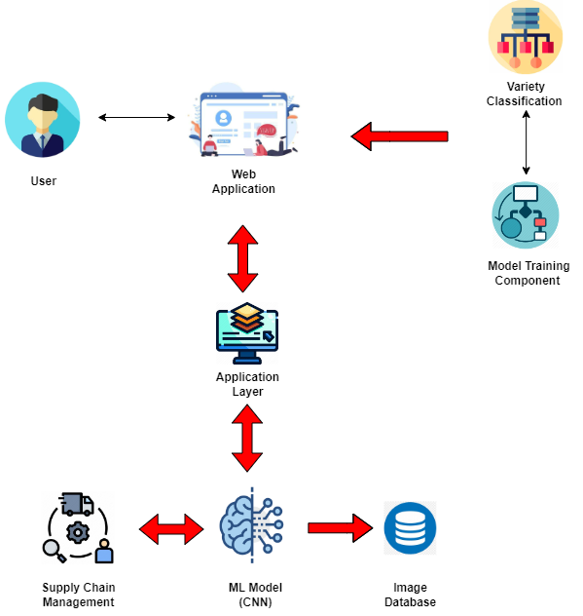
COMPONENT DIAGRAM
Mobile App
10/27/2024
IT21061066 | WELIGAMA D.M.P.D | RP-059

Slide 17
REQUIREMENTS
Variety model has 0.85+ F1-score
Real-time processing < 5 secs per image
Support heavy concurrent usage
Secure cloud data integrations
Well documented APIs
Inbuilt data validation checks
Functional Requirements
Non-Functional Requirements
Image uploads via web/mobile
CNN-based model for variety analysis
Variety, age, traits recognition
Integrate external/environment data
Generate personalized recommendations
Explain variety predictions visually
Incremental model updates
IT21061066 | WELIGAMA D.M.P.D | RP-059

Slide 18

Completion of project ​ ​
Completed Works
Acquired copra image dataset.
Identified the best image processing model.
Trained model to predict copra quality.
Designed system UI.
Collected test dataset for accuracy improvement.
Combined and trained CNN model for copra quality prediction.
Implemented backend.
Implemented frontend.
Interface Design, Improvements
Component Integration
IT21061066 | WELIGAMA D.M.P.D | RP-059

Slide 19

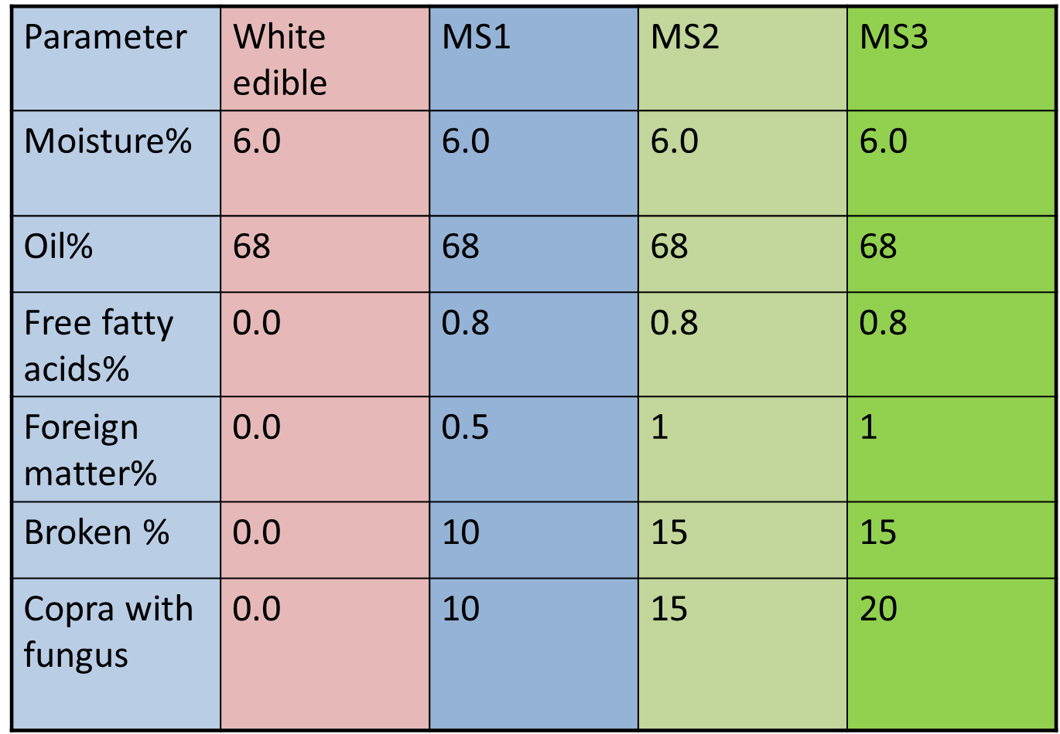
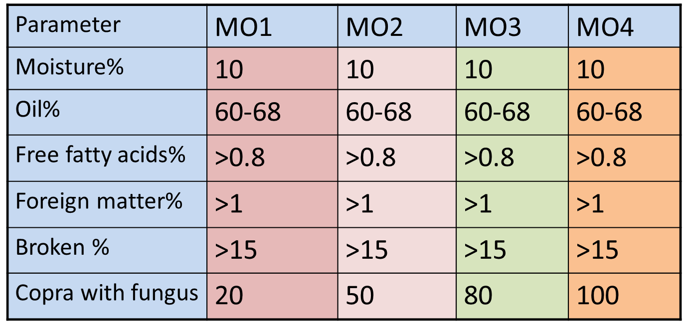

Completion of project [Contd] Data Collection
Sri Lankan standards for copra of milling superior quality
Sri Lankan standards for copra of MO grade

Slide 20
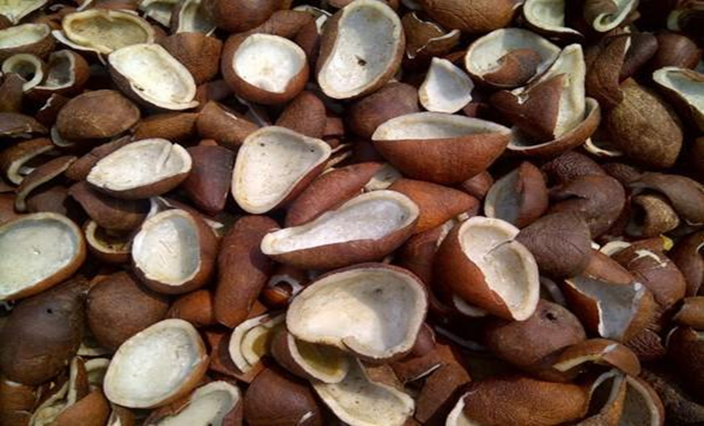
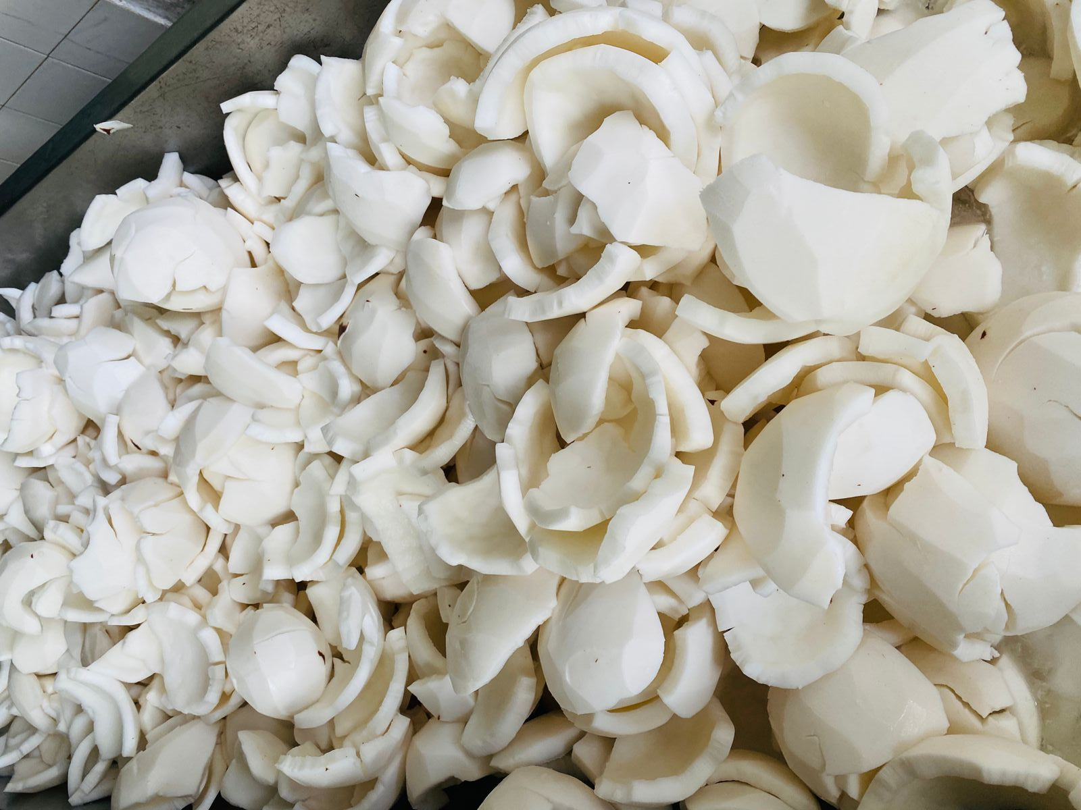
Data Collection
Copra Quality Levels:
Level 1: Define the characteristics of "perfect condition(Good)" copra for oil production. Category - [A]
Level 2: Specify the characteristics of "moderate(medium)" copra and its suitability for oil production. Category - [B]
Level 3: Define the characteristics of copra considered "not most suitable(Bad)" for oil production. Category - [C]

Slide 21
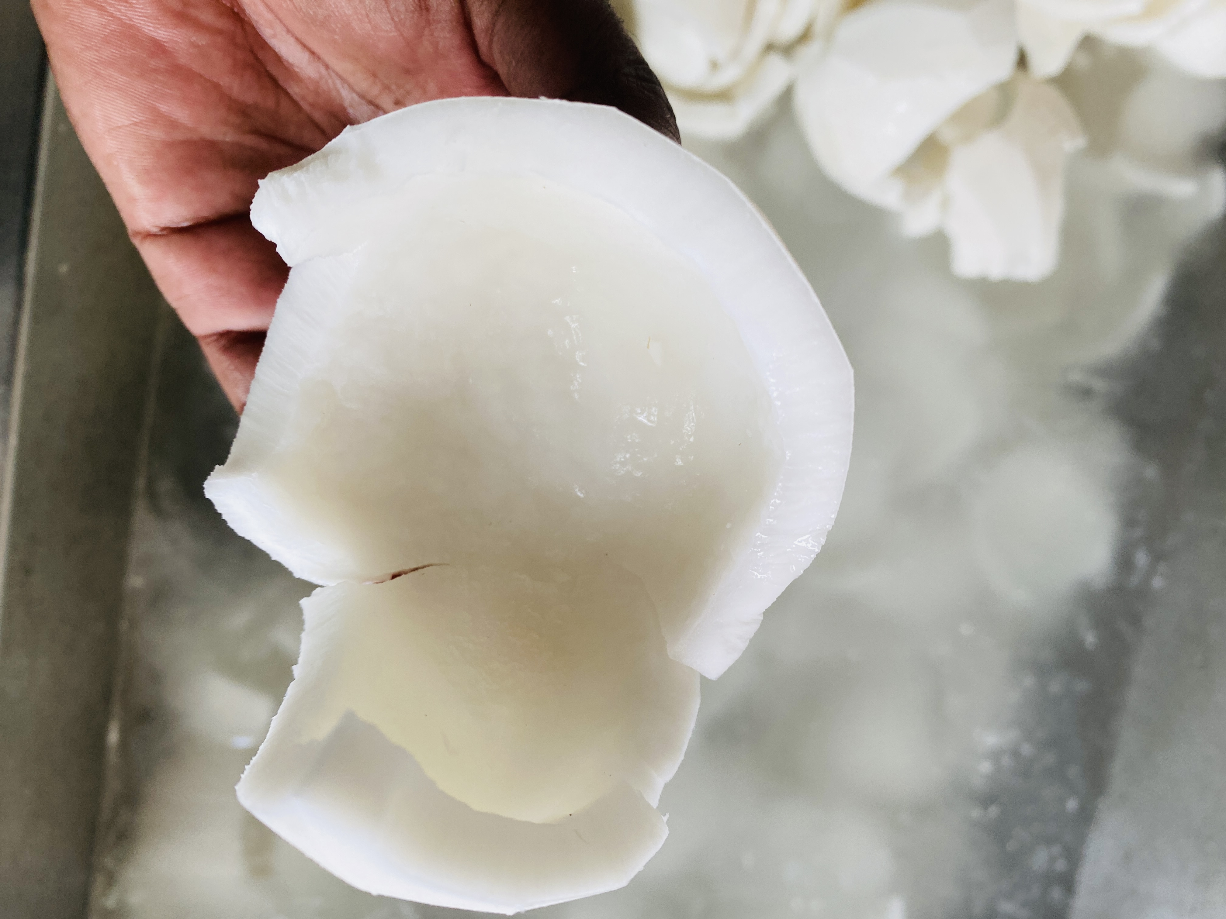
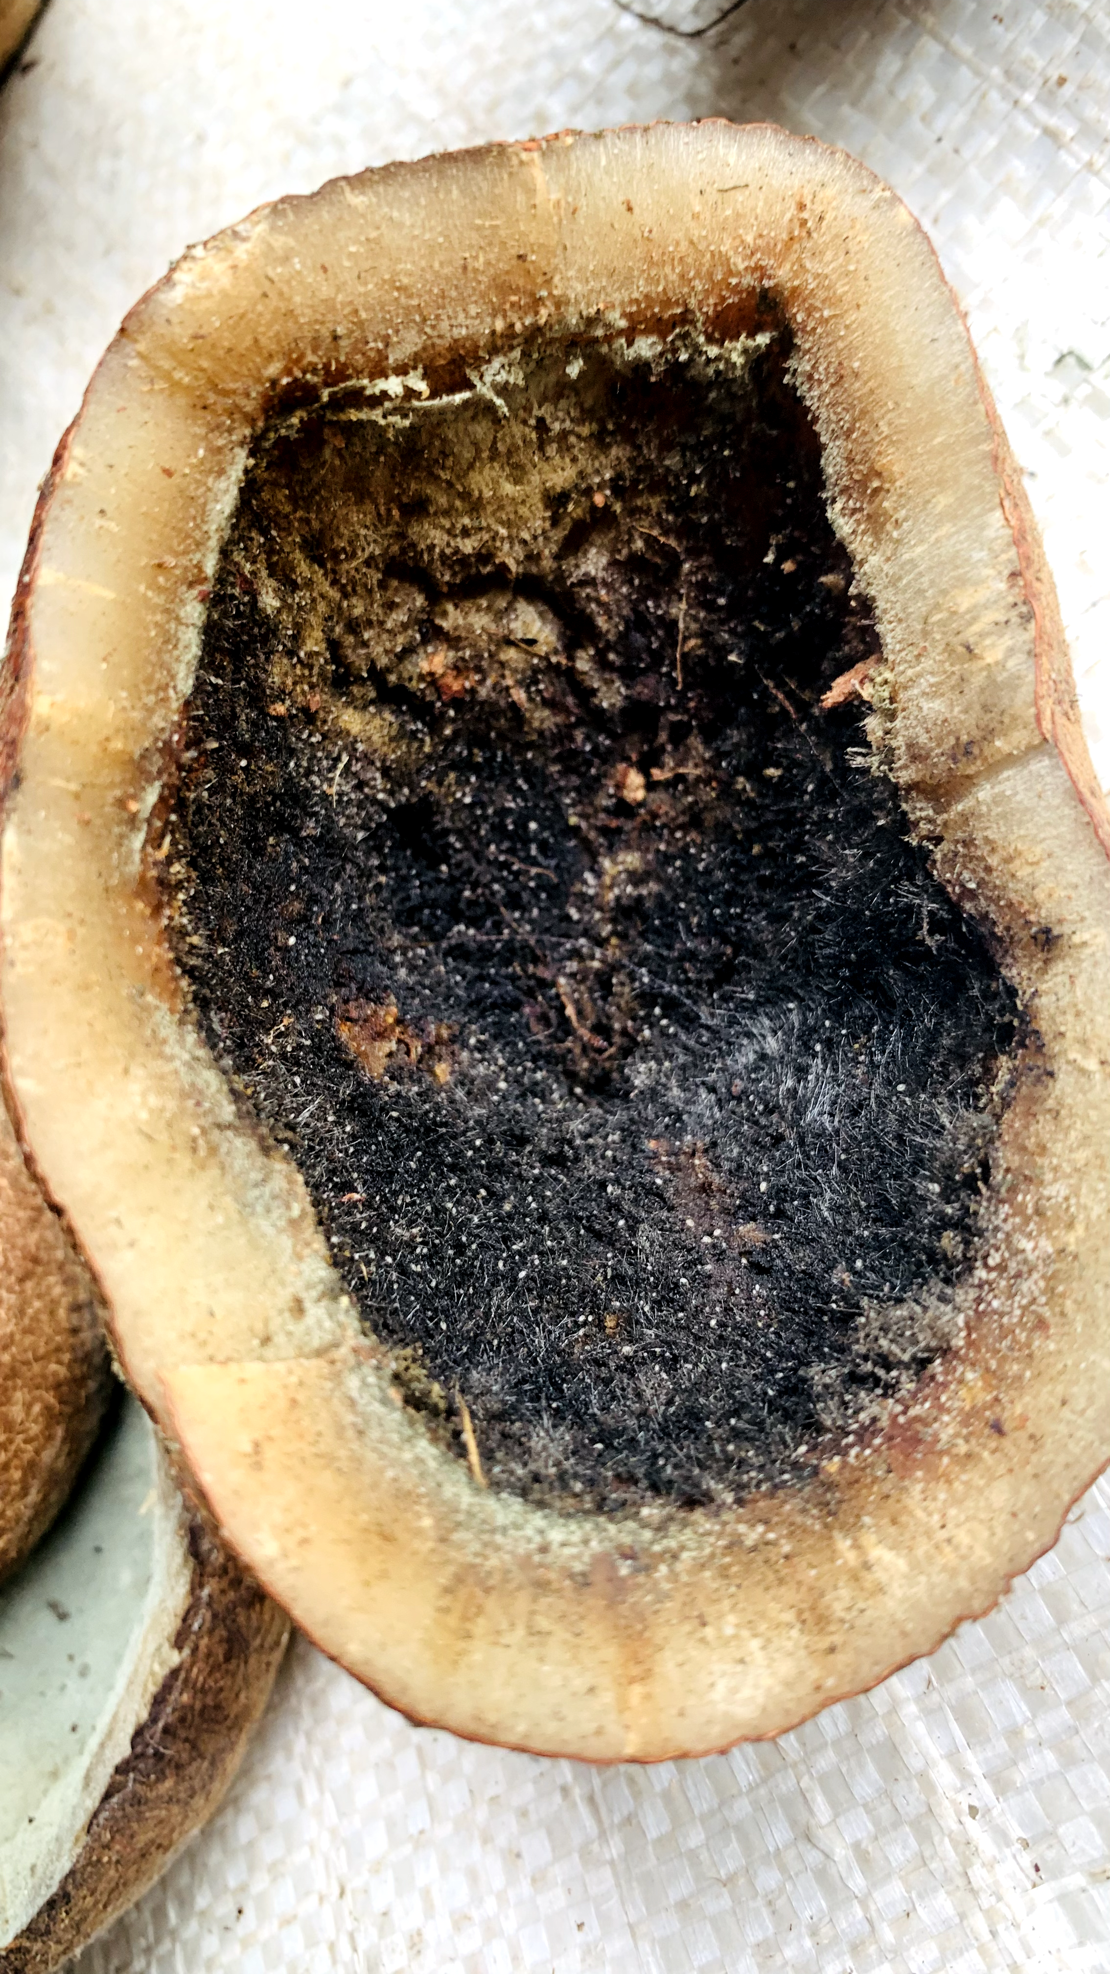
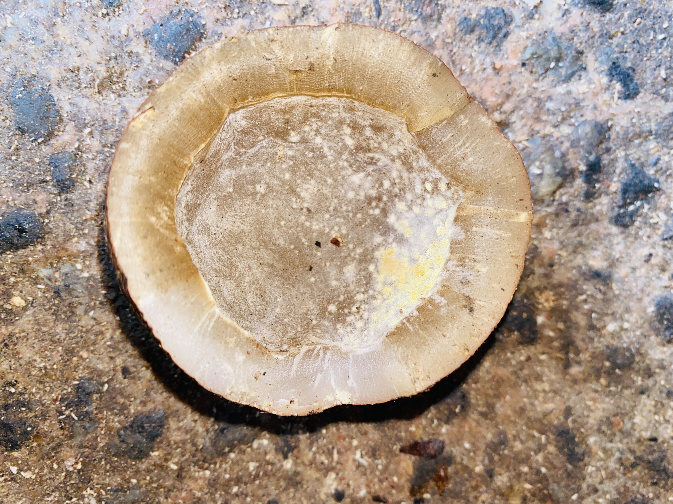
Data Collection
[A]
[B]
[C]

Slide 22
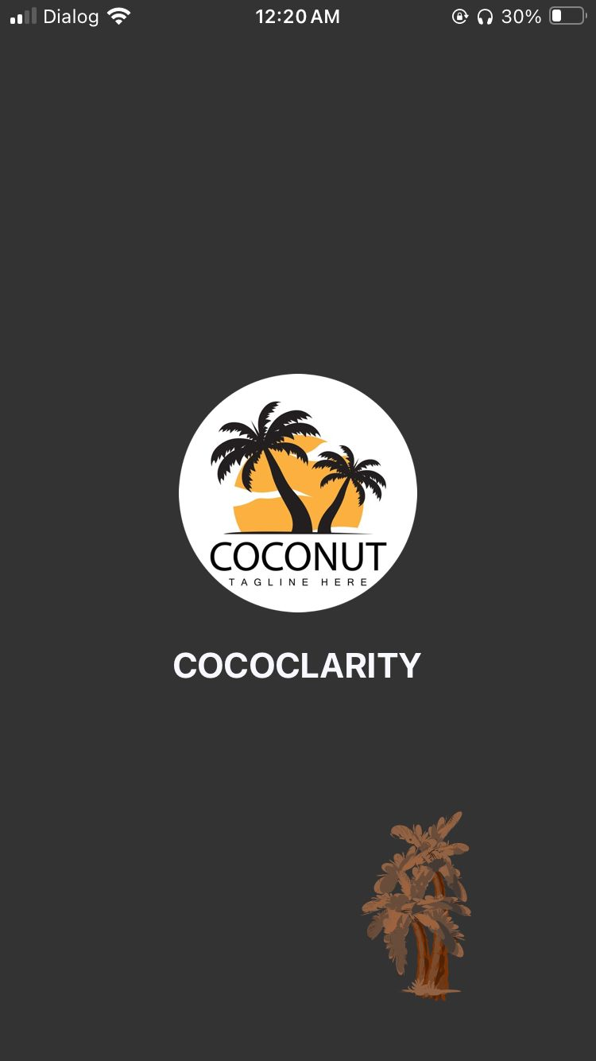
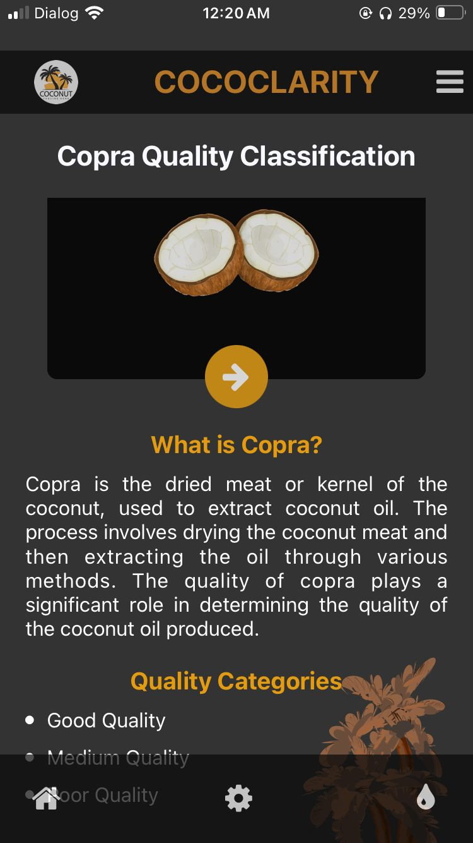
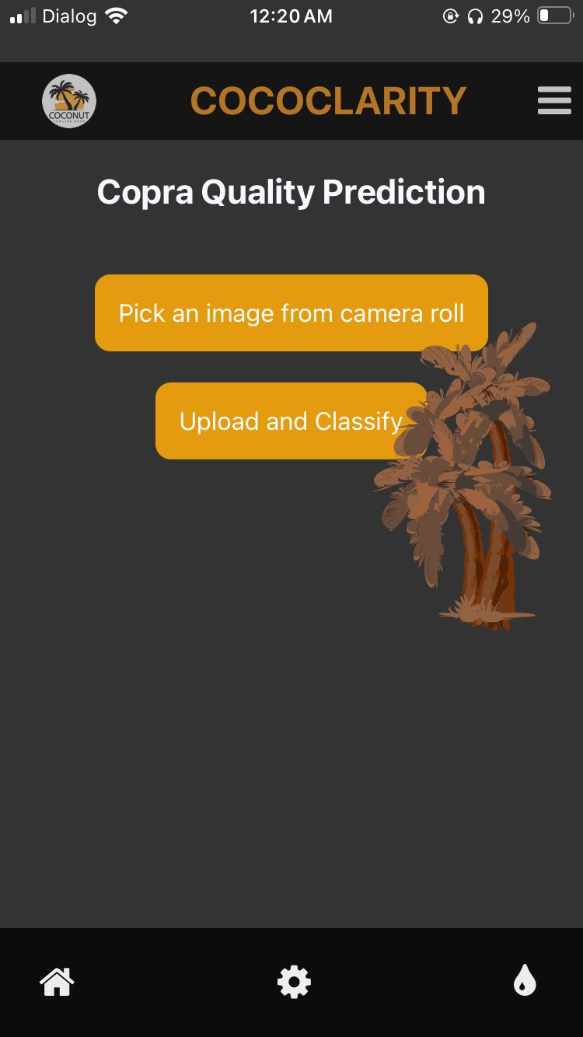
Achievement Evidence

Slide 23
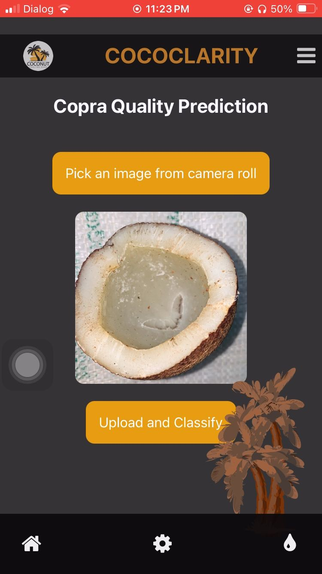
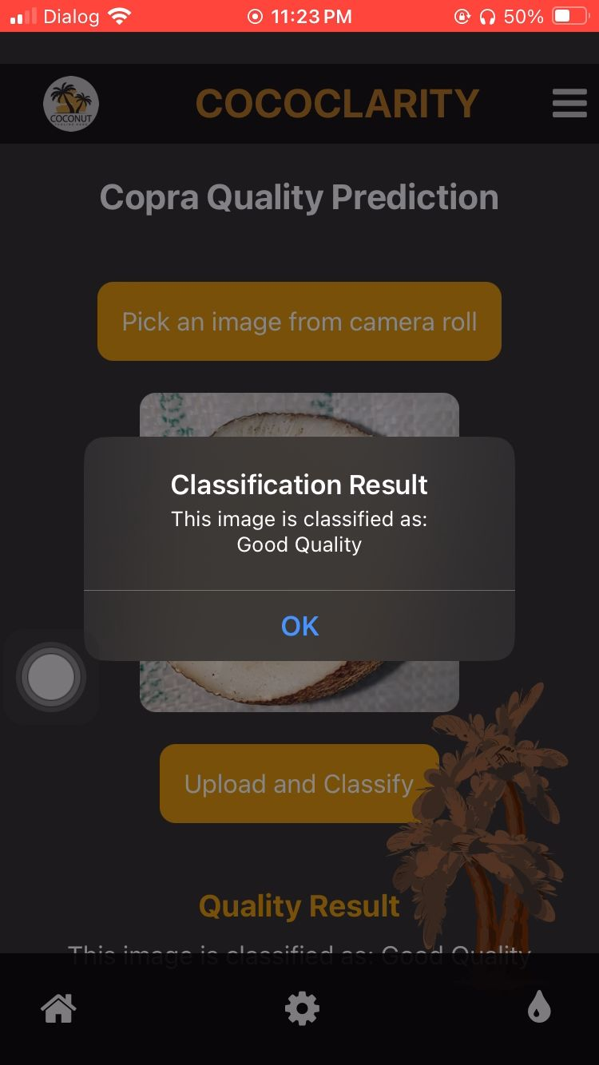
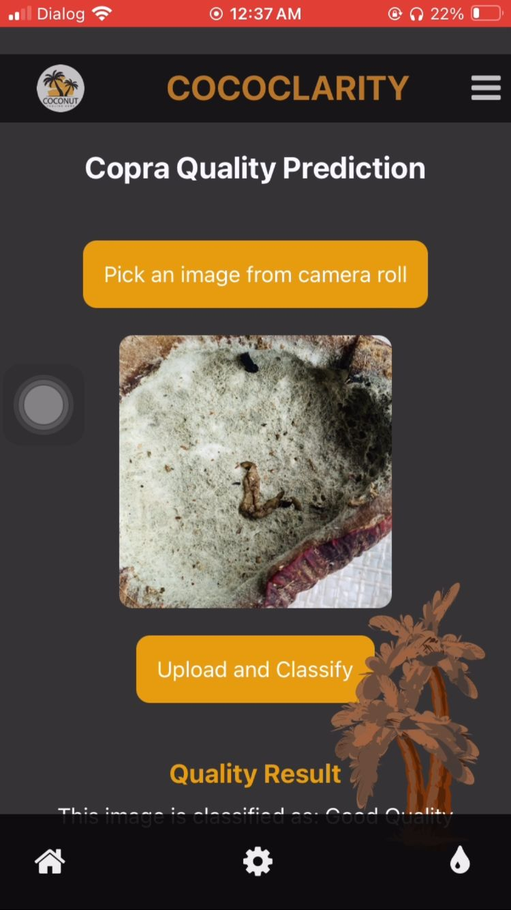
Achievement Evidence

Slide 24
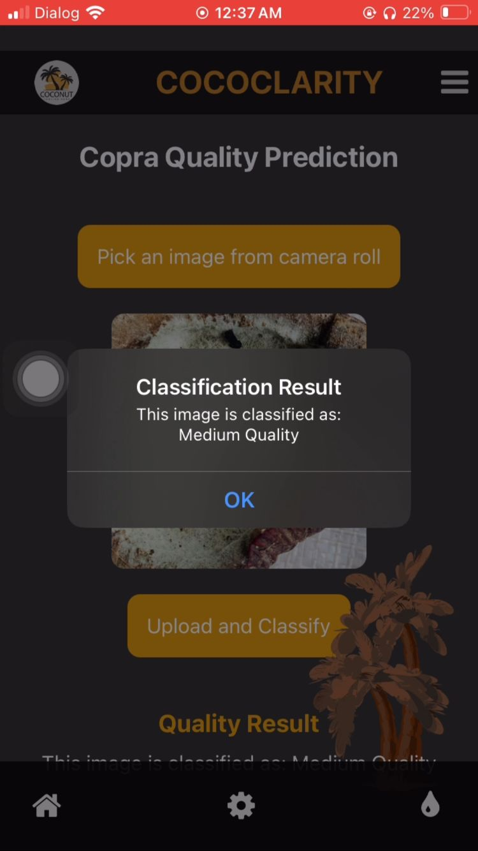
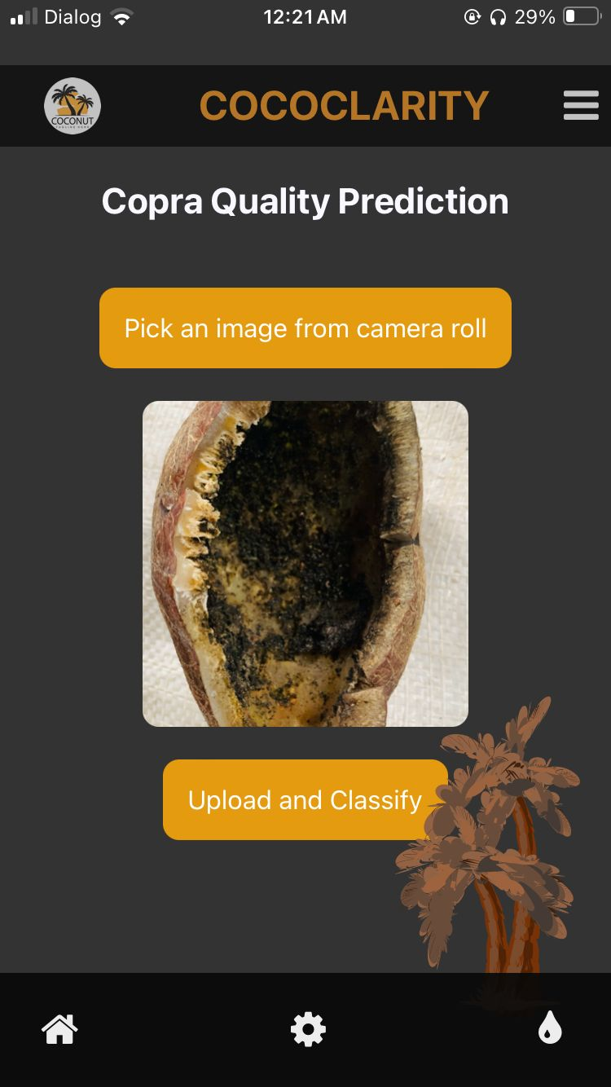
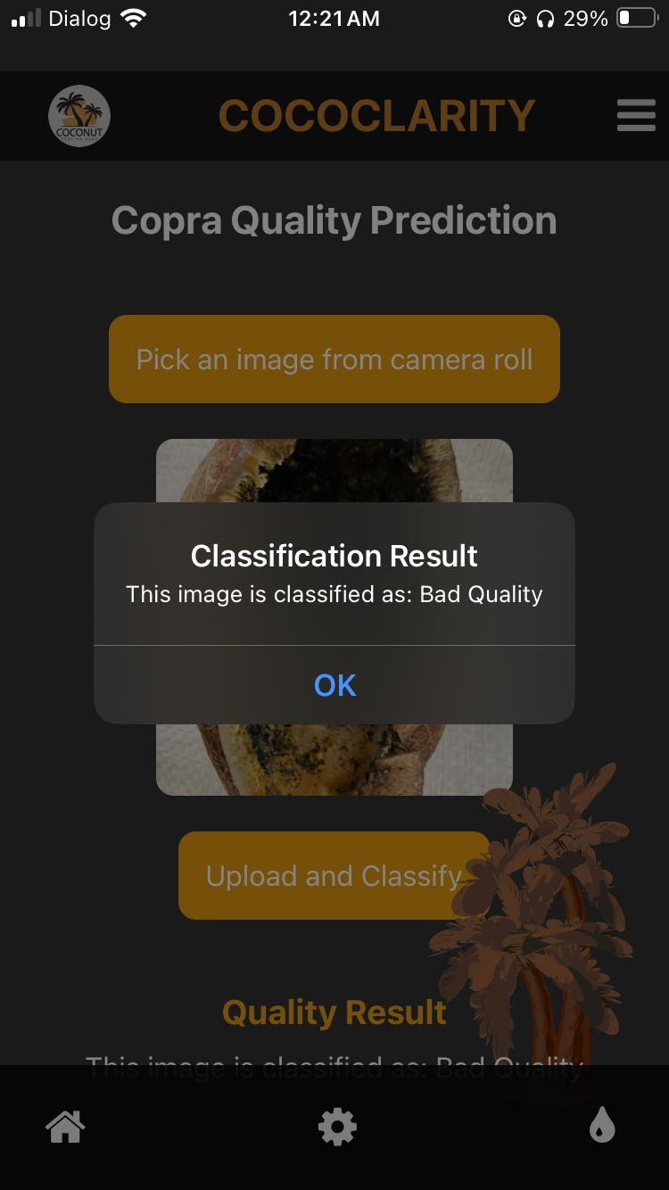
Achievement Evidence

Slide 25
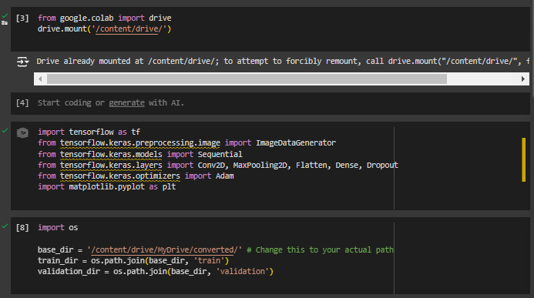
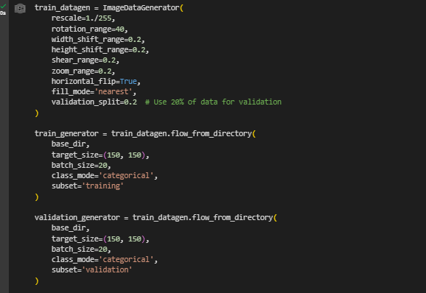
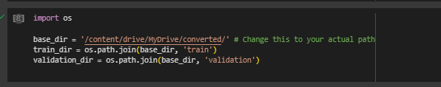
Data Pre-processing

Slide 26
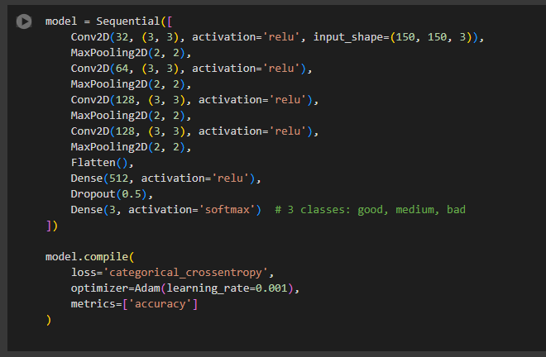
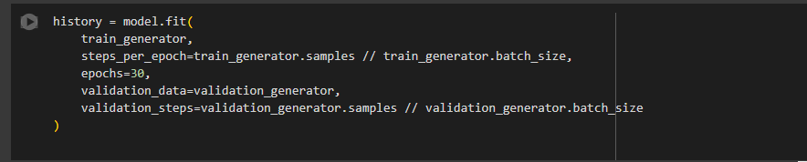
Train The Model

Slide 27
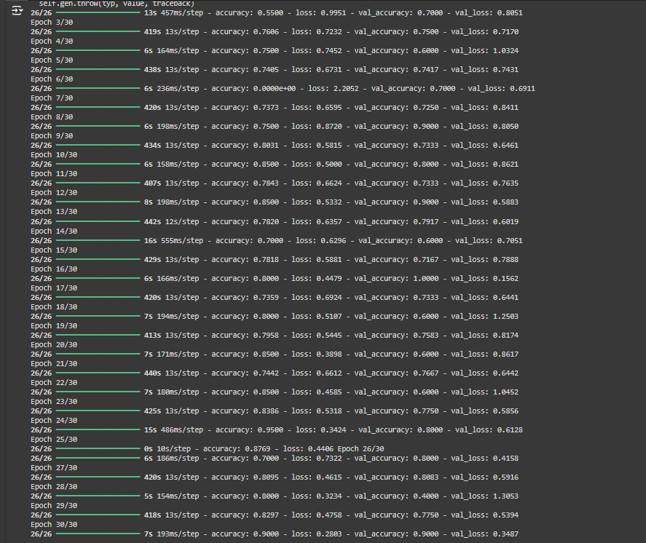
Accuracy
IT21061066 | WELIGAMA D.M.P.D | RP-059​

Slide 28
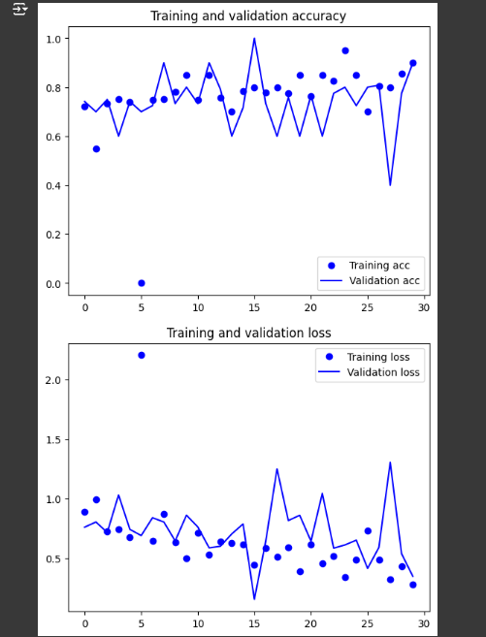
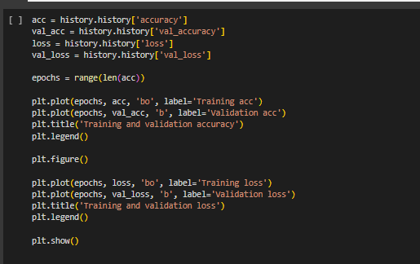
Accuracy
IT21061066 | WELIGAMA D.M.P.D | RP-059​

Slide 29
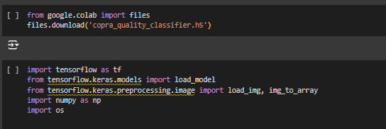
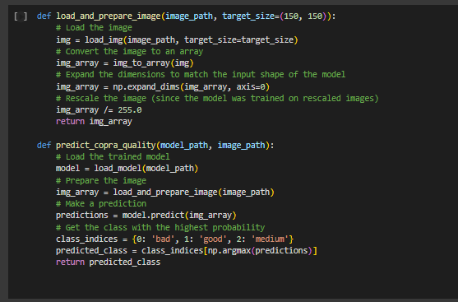

Prediction
IT21061066 | WELIGAMA D.M.P.D | RP-059​

Slide 30
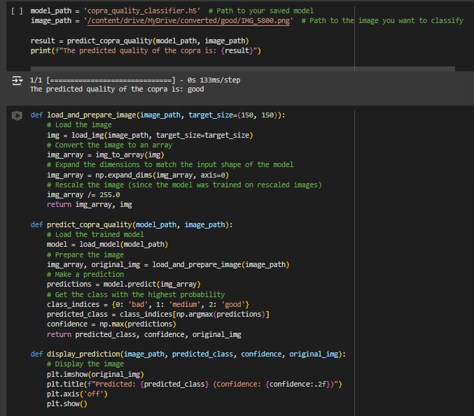
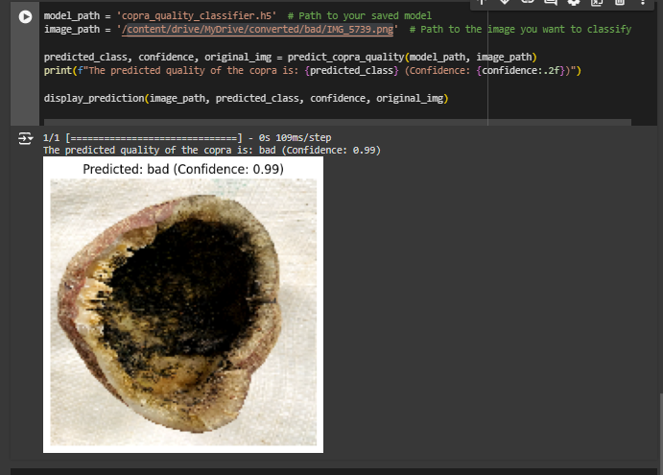
Prediction ​​
IT21061066 | WELIGAMA D.M.P.D | RP-059​

Slide 31
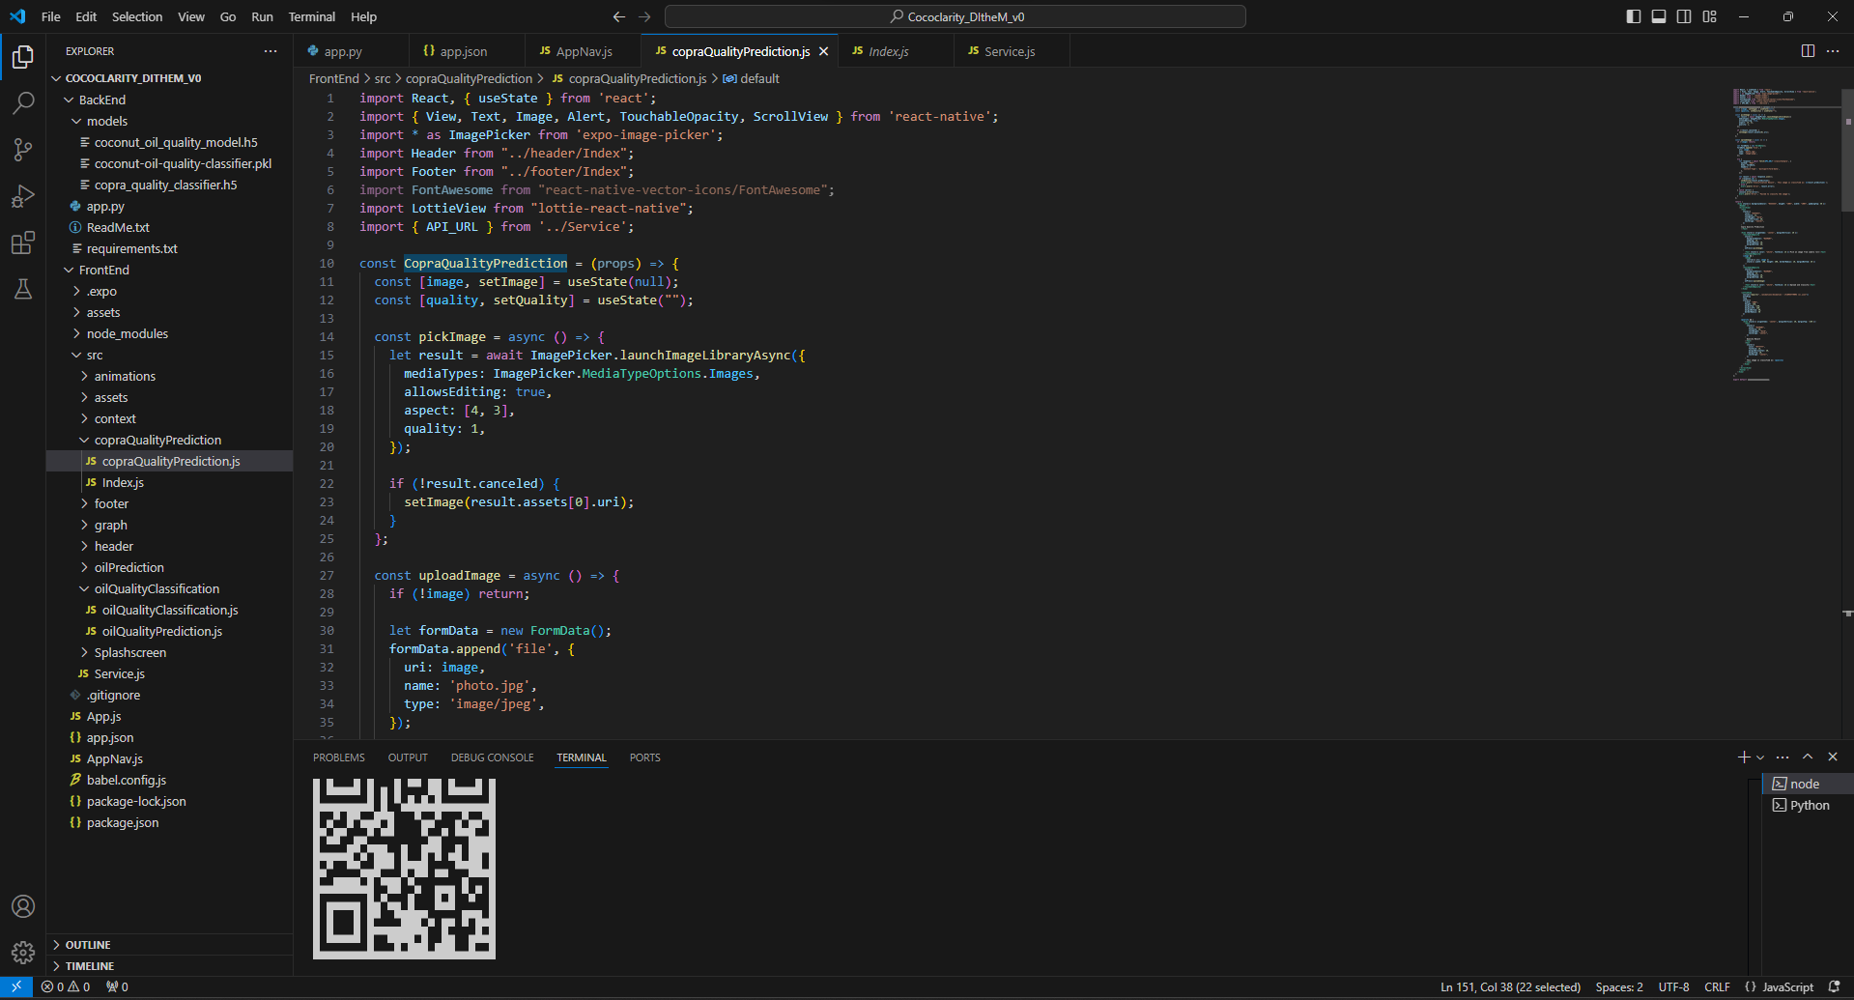
Implement Frontend
IT21061066 | WELIGAMA D.M.P.D | RP-059​

Slide 32
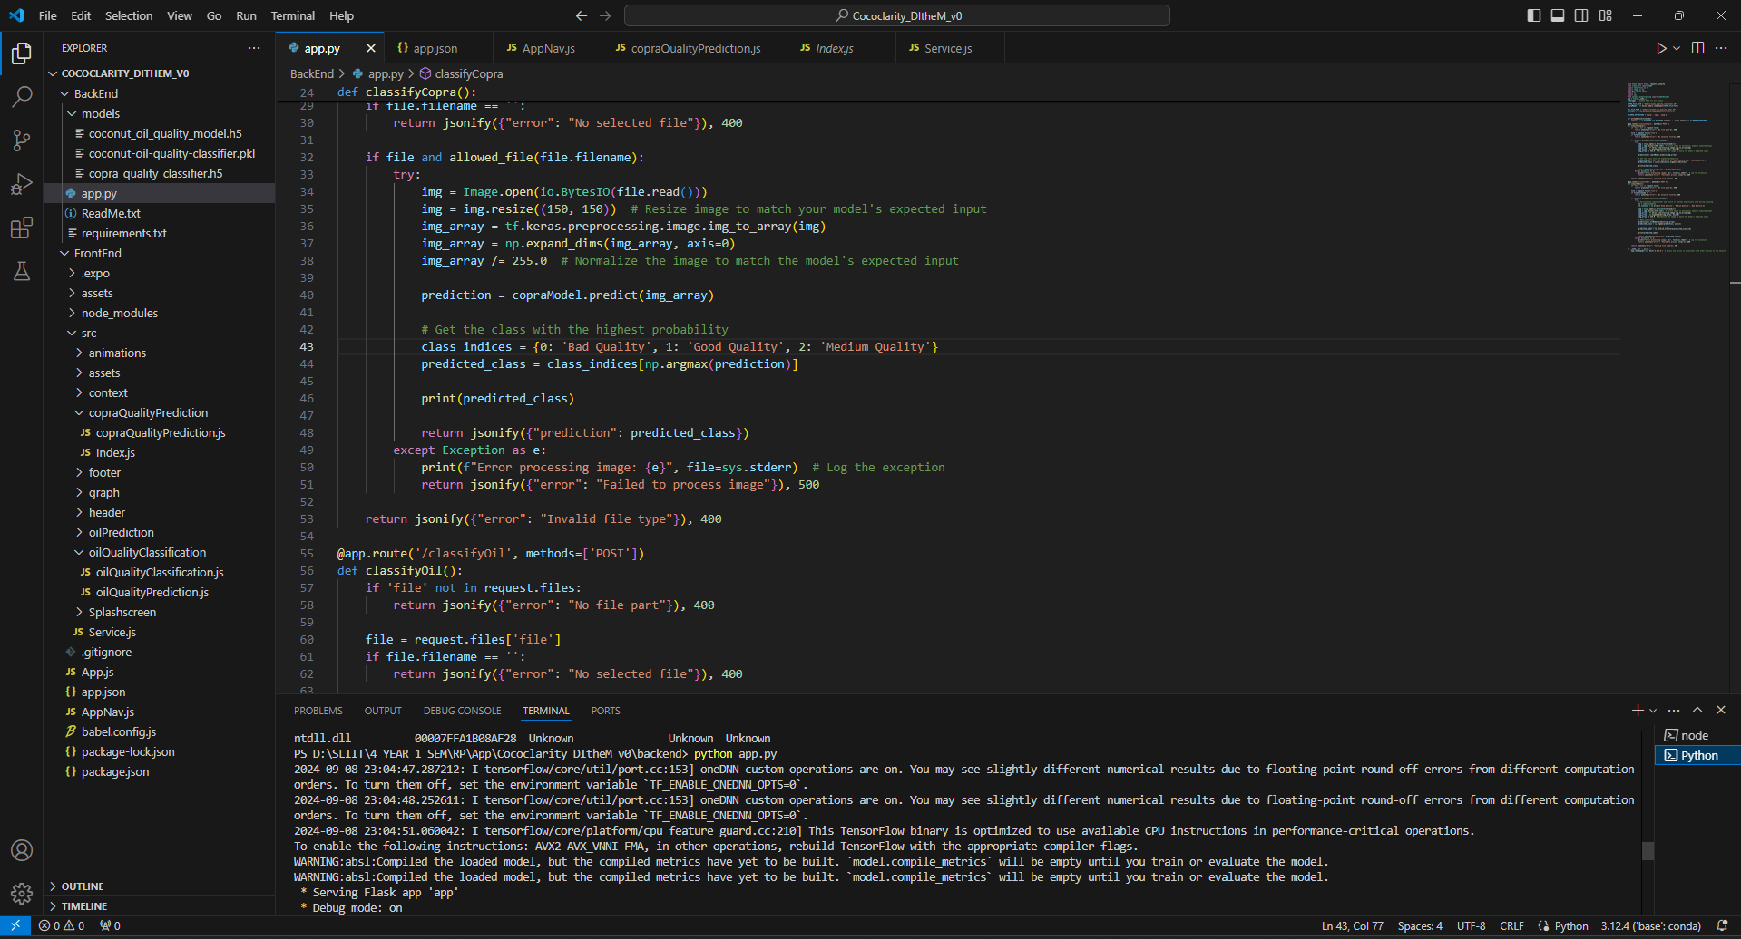
Implement Backend
IT21061066 | WELIGAMA D.M.P.D | RP-059​

Slide 33
References
[1] W. Wongseree, N. Pongpullponsak, S. Kittibunchakul, N. Yoisungnern, and T. Bunrit, “Classifying coconut varieties using leaf images and deep convolutional neural networks,” Computers and Electronics in Agriculture, vol. 179, p. 105777, 2020.
[2] S. Palaniswami, L. J. Motha, A. Al Jabri, and H. R. Ghassemi, “Automatic detection and classification of coconut mites using digital image processing,” Computers and Electronics in Agriculture, vol. 175, p. 105564, 2020.
[3] M. Nejati, M. M. Paydara, and M. J. Darabi, “Using artificial intelligence to estimate coconut oil productions regarding effective parameters,” Industrial Crops and Products, vol. 154, p. 112763, 2020.
[4] G. K. Nair, B. Krishnan, S. N. Omkar, and T. Srinivas, “Coconut yield prediction using machine learning techniques,” Journal of Statistics and Management Systems, pp. 1–9, 2022.
[5] J. Lee, A. Krizhevsky, and I. Sutskever, “Using client feedback to continually improve image classification performance,” Communications of the ACM, vol. 64, no. 7, pp. 54–61, 2021.
IT21061066 | WELIGAMA D.M.P.D | RP-059

Slide 34
IT21020308 | DEWMINI A.M
IT Specialization
Oil Product Yield Estimator
IT21020308 | DEWMINI A.M. | RP-059
10/27/2024 19

Slide 35
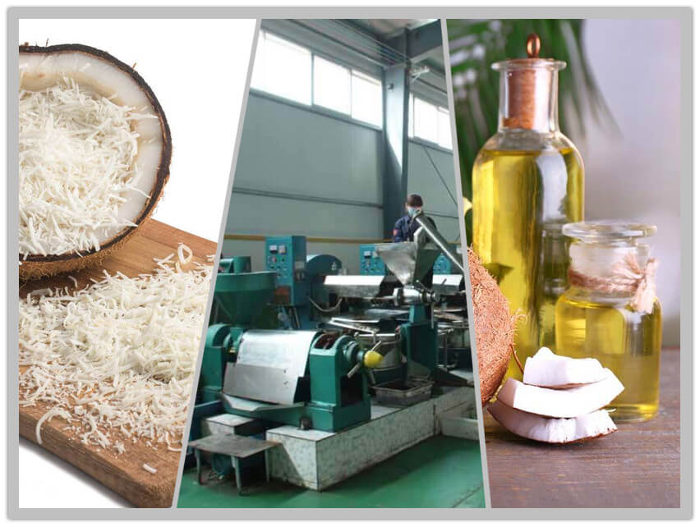
Background of the Study
Coconut oil production's impact on economic growth and exports
coconut oil production trends is crucial for policymakers and industry stakeholders to make informed decisions about resource allocation, trade policies, and economic planning.
The role of by-products (kurutu, coconut shell, oil cake, coconut water) in coconut processing.
Coconut yields can be affected by various factors such as weather condition and diseases, leading to fluctuations in production levels.
IT21020308 | DEWMINI A.M. | RP-059

Slide 36

RESEARCH PROBLEM
Inconsistent Yield Prediction
Underutilization of Advanced Predictive Analytics
Insufficient Focus on Sustainability
IT21020308 | DEWMINI A.M. | RP-059
10/27/2024

Slide 37
Research Gap of the Study
Insufficient Integration of Advanced Technologies
Limited predictive models that leverage kurutu data for secondary oil yield predictions
Impact of Inaccurate Predictions on Operational Efficiency
Need for a Sustainable and Profitable Approach
Opportunities for Improvement in Decision-Making
IT21020308 | DEWMINI A.M. | RP-059

Slide 38

Objectives of the Study
MAIN OBJECTIVES
Develop a system that predicts the number of coconuts needed to meet future oil demand, while also predicting by-products.
SUB OBJECTIVES
Analyze historical yields data
Incorporate external influencing factors
Continuous model optimization for precision
User friendly dashboards for growers
IT21020308 | DEWMINI A.M. | RP-059

Slide 39

NOVELTY
Linking granular coconut profiles to past outputs
Adaptive learning mechanisms unique to region
Automated, tailored recommendations
IT21020308 | DEWMINI A.M. | RP-059

Slide 40
METHODOLOGY
Data Collection
Data Visualization
Data pre-processing
Host the finalized model in the flask server
Data augmentation and the best technique to retrain models to aselectedchieve good
Displayed the results in mobile application
IT21020308 | DEWMINI A.M. | RP-059

Slide 41
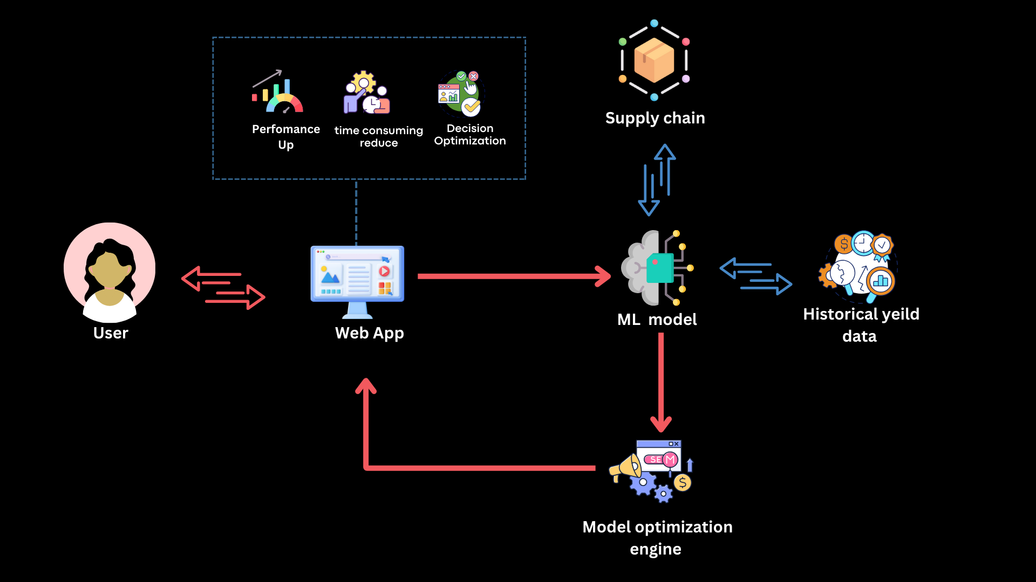

COMPONENT DIAGRAM
Kurutu data
Mobile App
IT21020308 | DEWMINI A.M. | RP-059

Slide 42
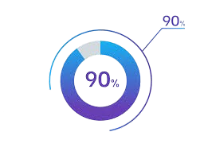
Completion of the project
Completed Works
Find the historical data set for coconut oil production
Find the historical data set of Coconuts/ kurutu/ oil cake/ coconut shell/ Coconut water
Designing an UI for System
Train the model for predict forecast oil production
Combined and Train the model(Random Forest Regressor model/ Decision Tree model) for predict forecast oil production
Implement of the backend
Implement of the frontend
Future Works
Some Design interface changes
Integrated All Components
IT21020308 | DEWMINI A.M. | RP-059

Slide 43
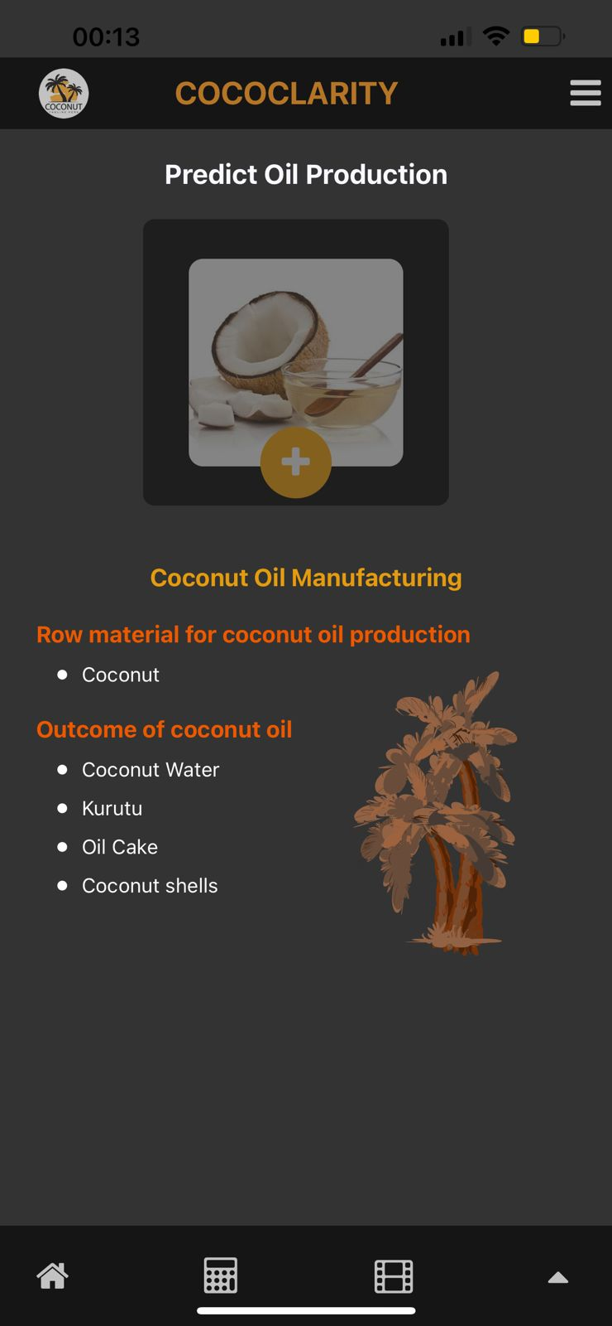
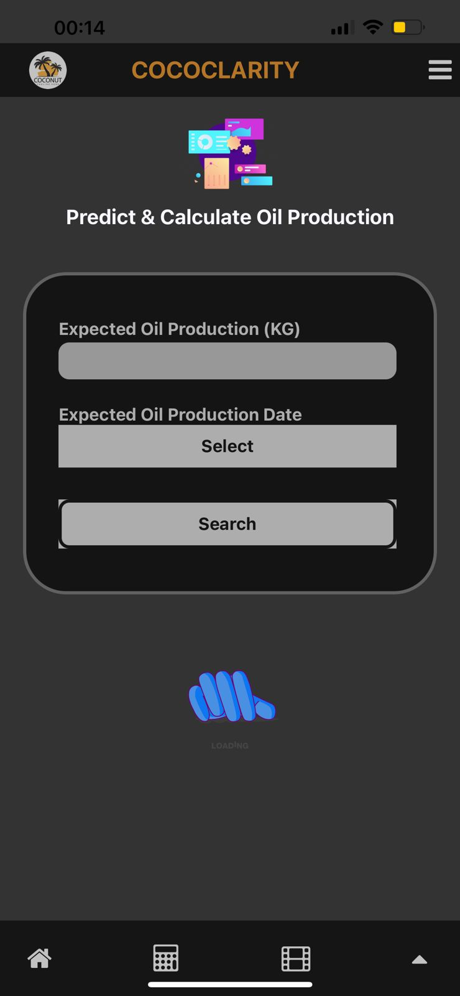
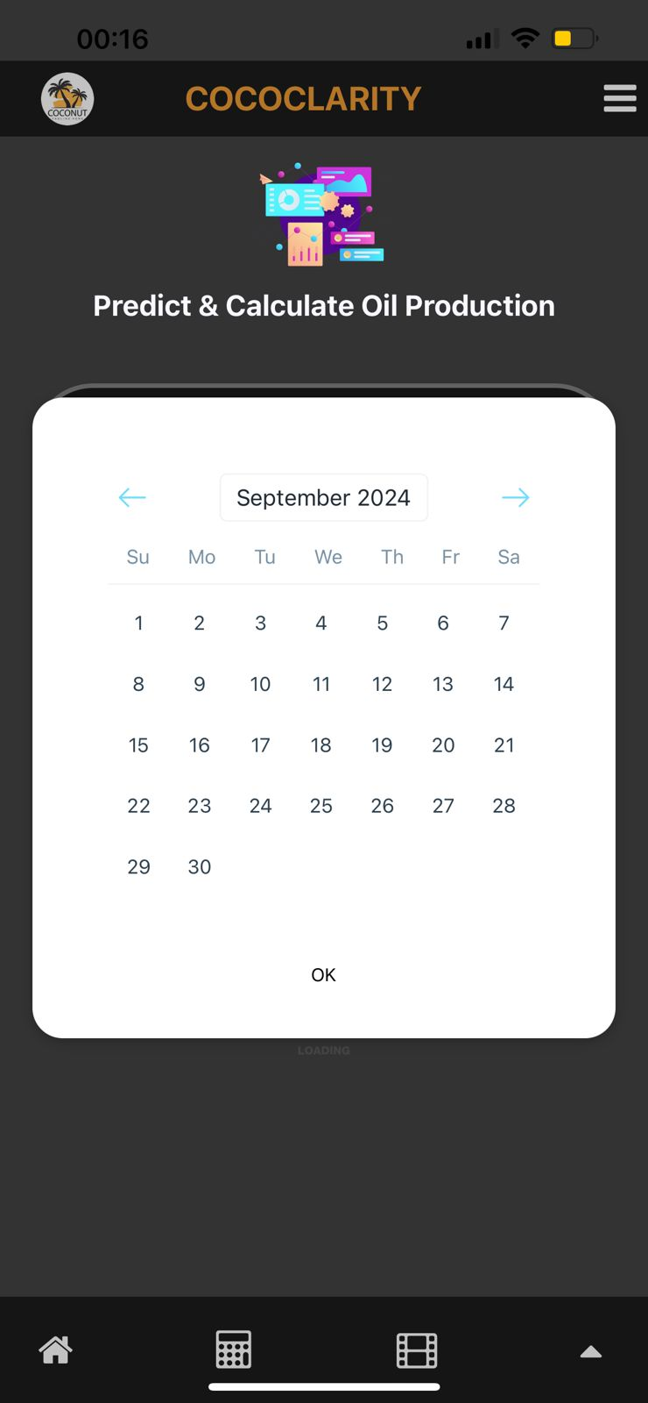
Achievement Evidence
IT21020308 | DEWMINI A.M. | RP-059

Slide 44
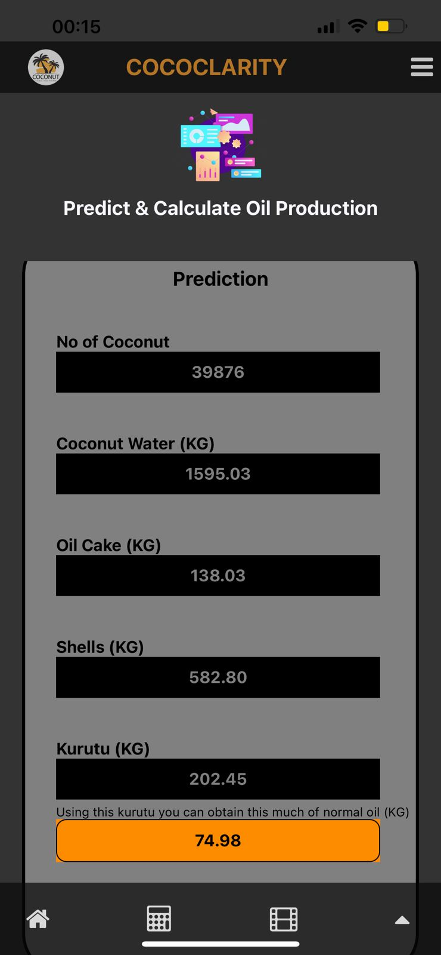
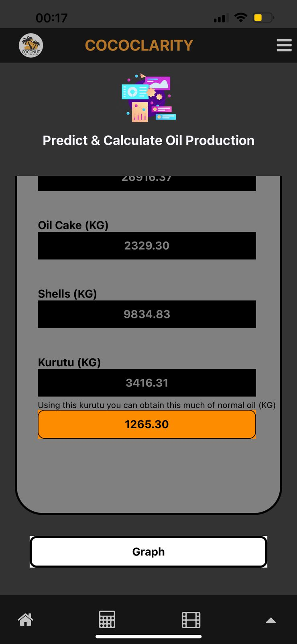
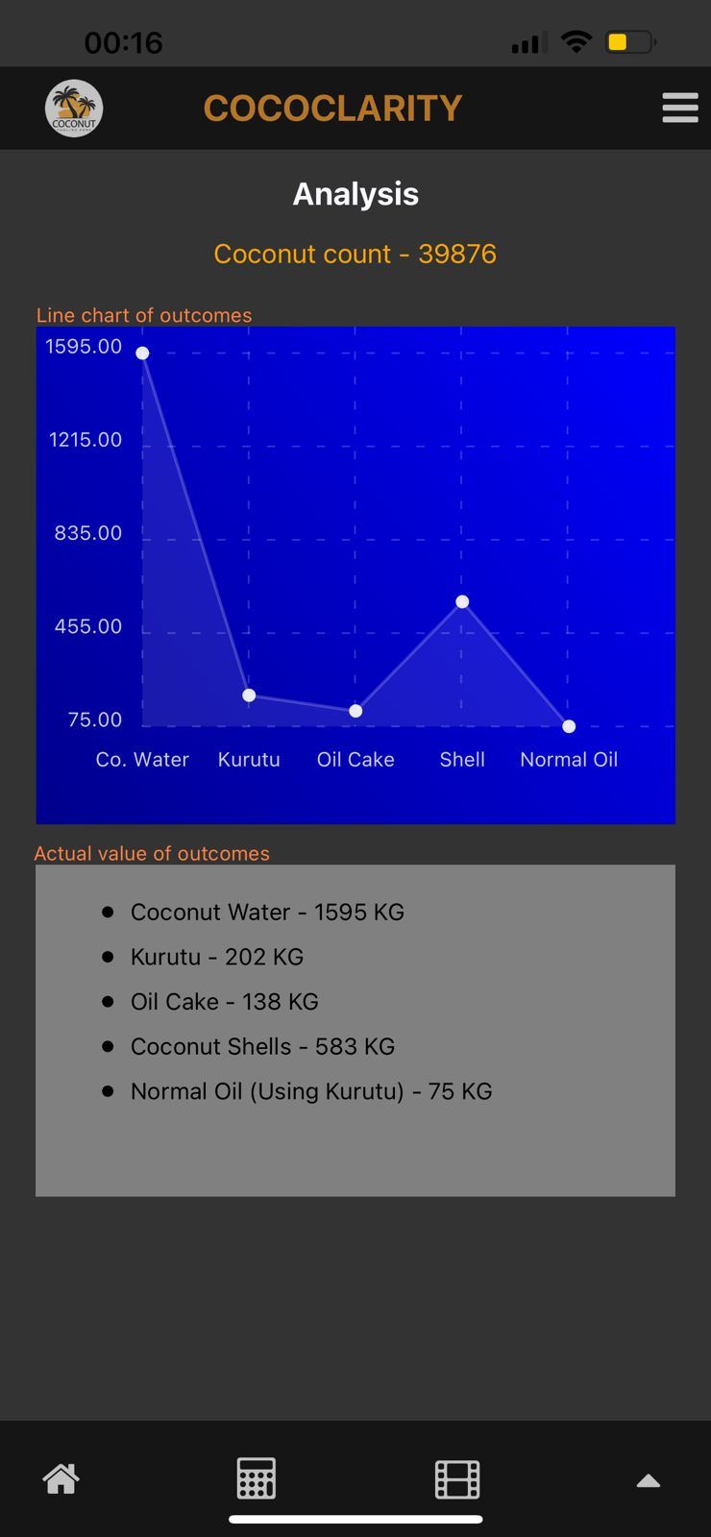
Achievement Evidence
IT21020308 | DEWMINI A.M. | RP-059

Slide 45
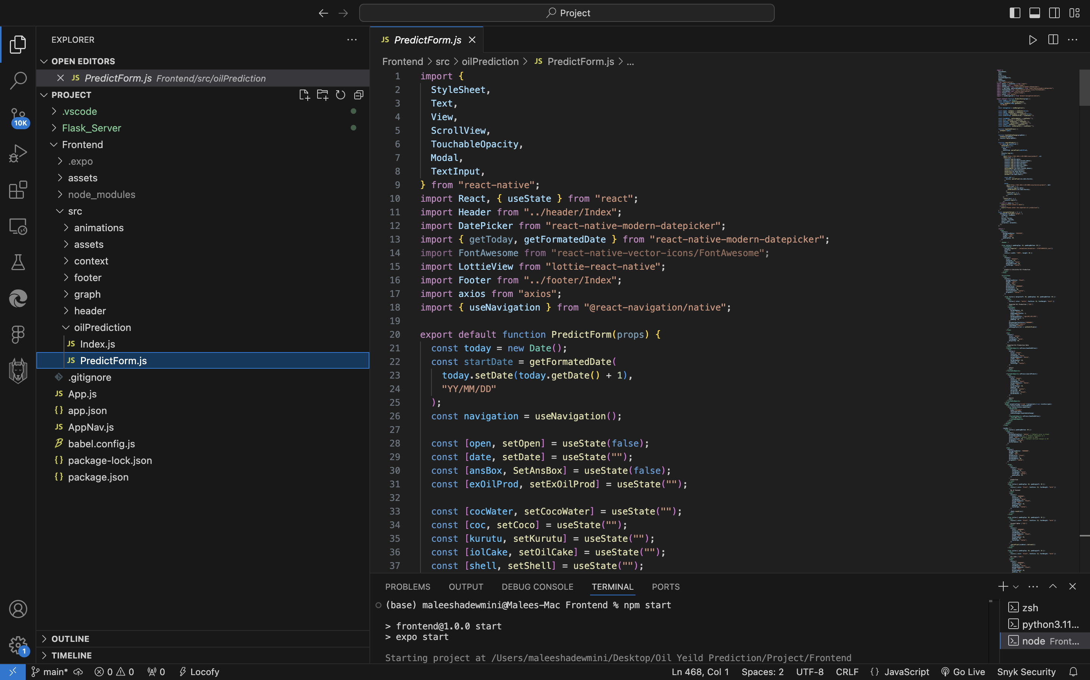
Implement Frontend
IT21020308 | DEWMINI A.M. | RP-059

Slide 46
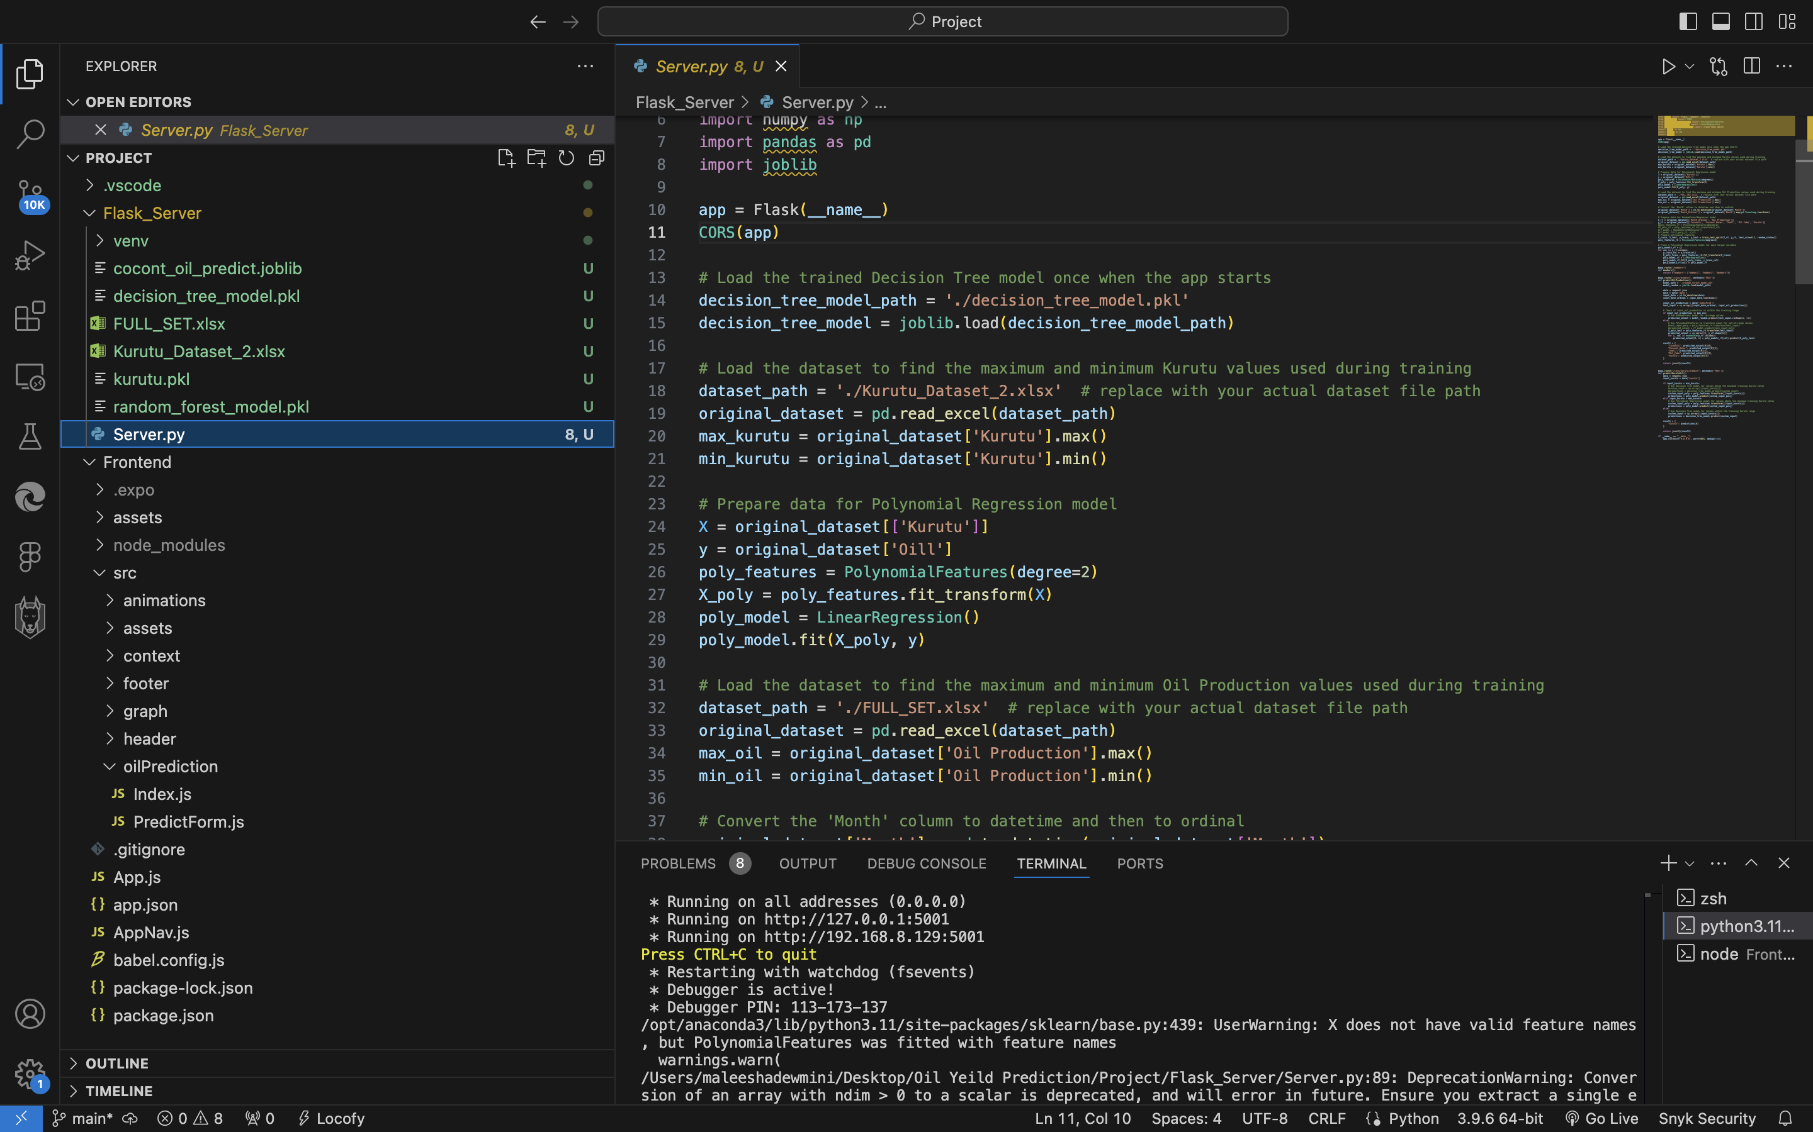
Implement Backend
IT21020308 | DEWMINI A.M. | RP-059

Slide 47
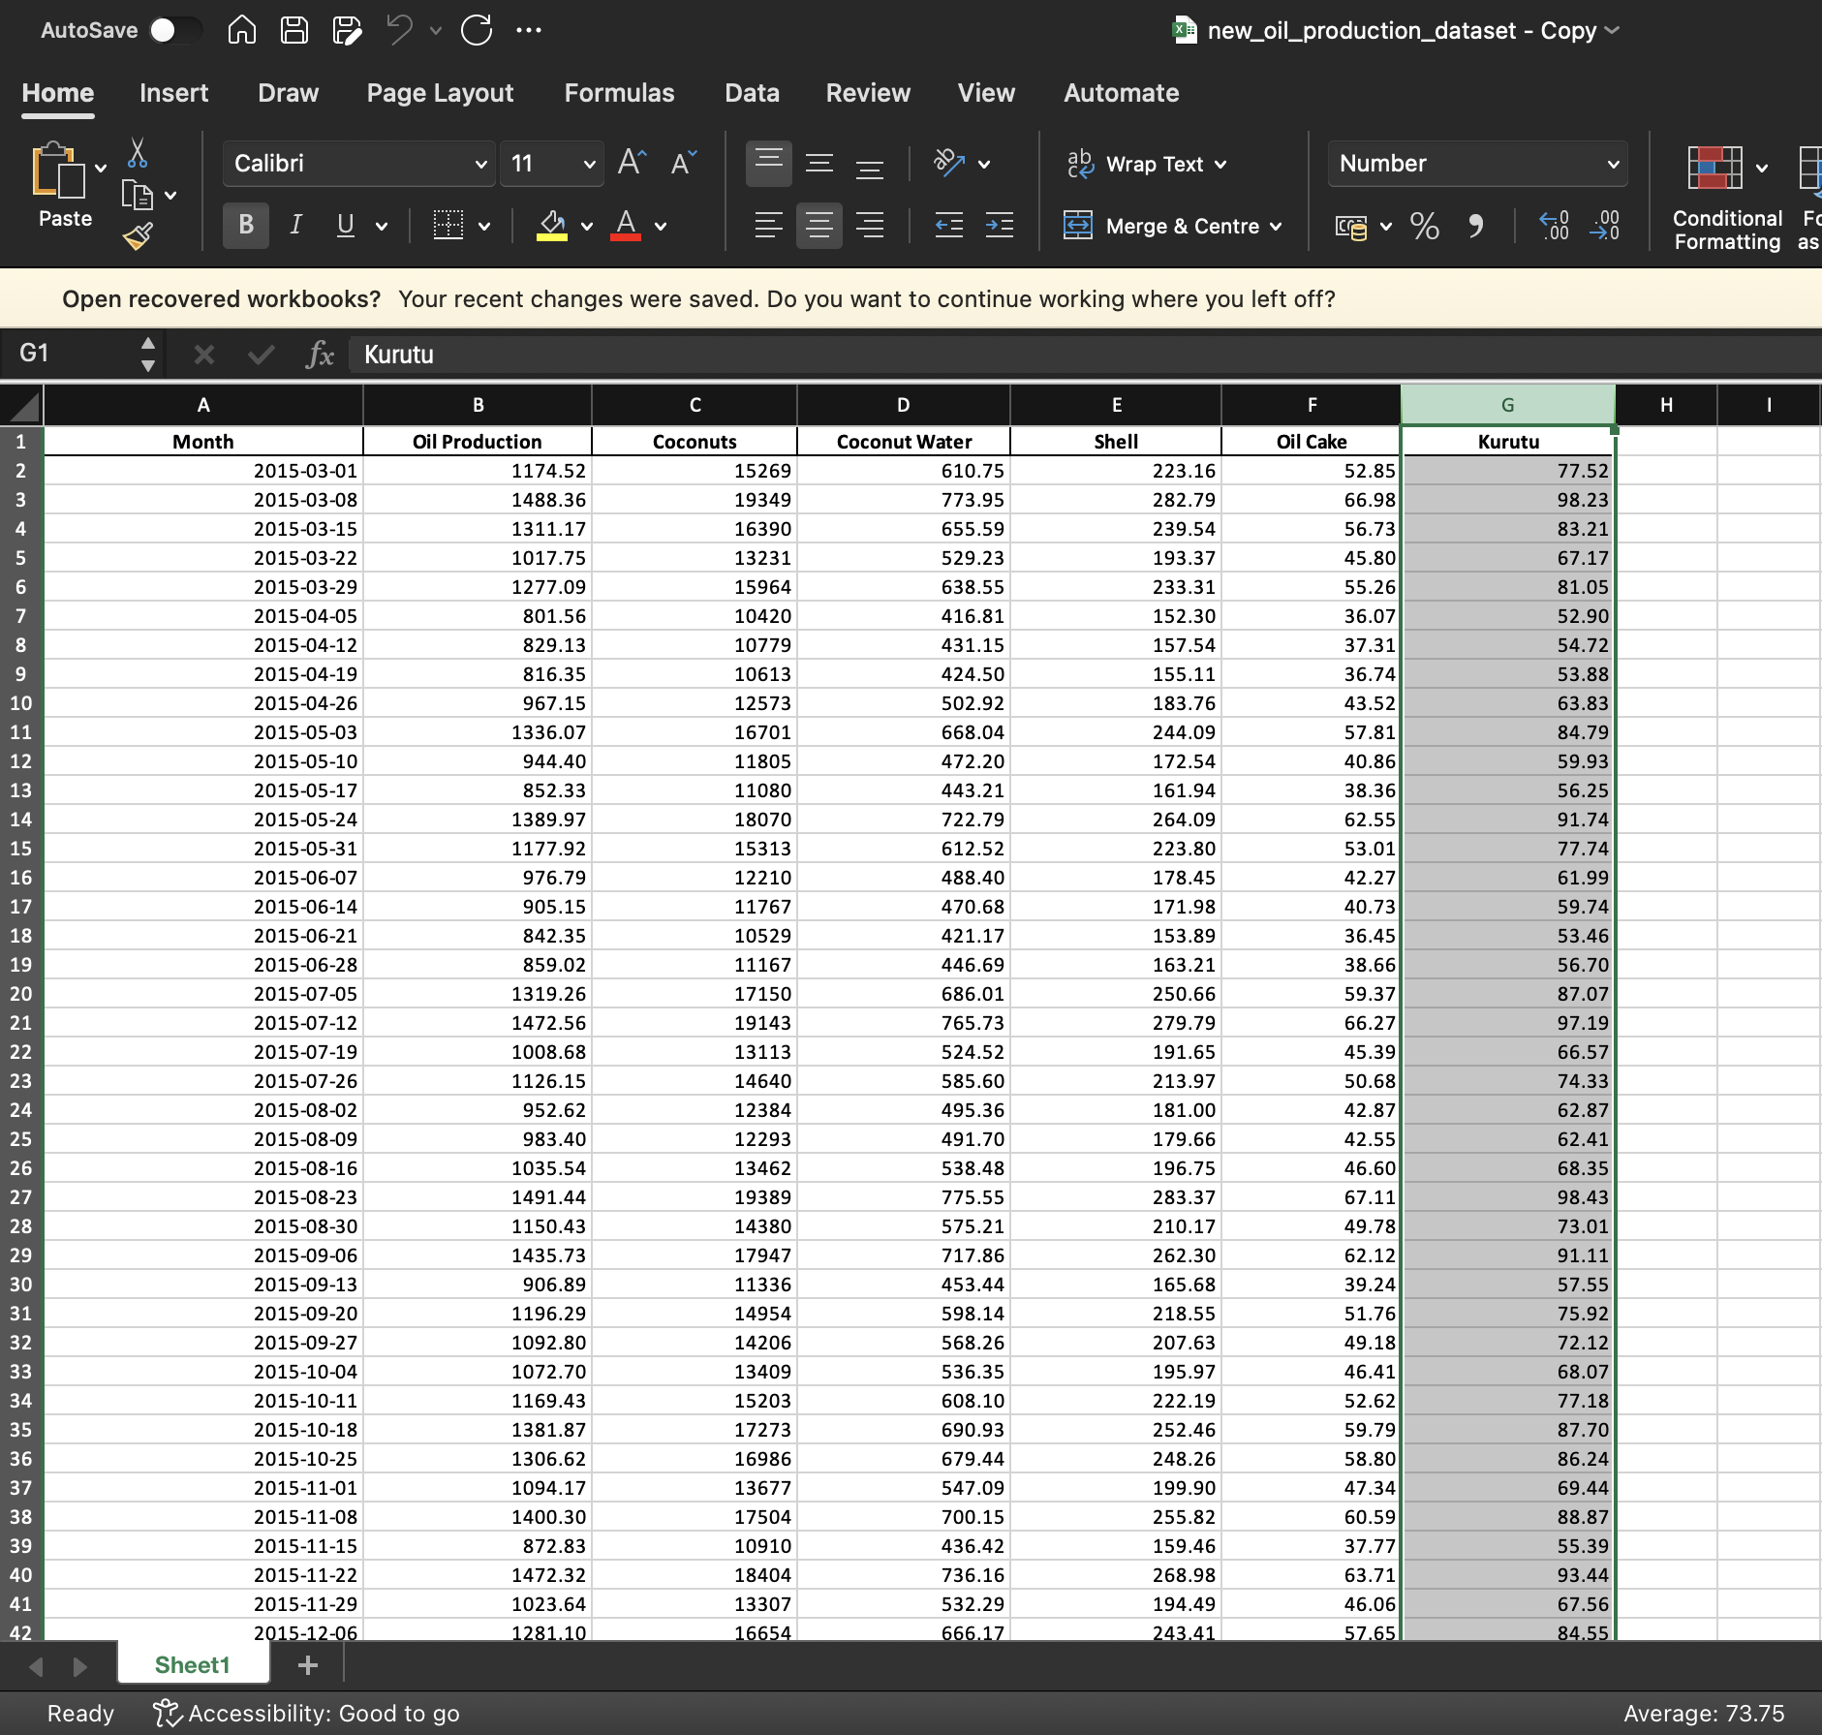


Completion of project
Oil yeald of 10 years in each months
Features – 7 (Month/Oil Production/Coconuts/Coconut water/Shell/Oil Cake/Kurutu)
Record – 3000+
IT21020308 | DEWMINI A.M. | RP-059

Slide 48









Completion of project
Import libraries
Preprocess Data Format
Plot Original Data
Grid Search optimal parameters
Fit Random Forest Model
Forecast & Evaluate Accuracy
Forecast Long term
Plot Forecast Data
Plot Forecast + Original Data
IT21020308 | DEWMINI A.M. | RP-059

Slide 49



Train The Model
Fit the Random Forest model with the best parameters found.
IT21020308 | DEWMINI A.M. | RP-059

Slide 50


Train The Model
Perform grid search to find best Decision tree model
IT21020308 | DEWMINI A.M. | RP-059

Slide 51


Accuracy & Predict forecast
Forecast oil production for the next 3 months, calculate accuracy metrics against actual 2023 data.
Forecast oil production for the next 12 months, combine original and forecasted data, save to CSV.
IT21020308 | DEWMINI A.M. | RP-059

Slide 52

Visualize Forecast Data
IT21020308 | DEWMINI A.M. | RP-059

Slide 53
References
[1] J. Smith, A. Johnson, and B. Williams, “Traditional forecasting methods for agricultural yield prediction,” IEEE Transactions on Sustainable Agriculture, vol. 1, no. 2, pp. 76-89, (2019)
[2] S. Lee and J. Park, “Crop cultivation data analytics for precision agriculture,” IEEE Internet of Things Journal, vol. 8, no. 11, pp. 12387–12394, (2021)
[3 ] M. Rodriguez, G. Bondi, and G. Mangano, “Economic optimization of agricultural processes,” IEEE Robotics and Automation Letters, vol. 5, no. 2, pp. 3019-3026, (2020)
[4] J. Costa, M. Matte, and G. Reinehr, “Applications of AI in agriculture: A survey,” IEEE Access, vol. 6, pp. 78221-78245, (2018)
[5] M. Ahmed, J. S. Srai, and M. Hussain, “Blockchain for transparent and efficient agri-food supply chains,” IEEE Transactions on Engineering Management, vol. 69, no. 4, pp. 1465-1475, (2022)
IT21020308 | DEWMINI A.M. | RP-059

Slide 54
IT21103322| Bandara A.M.S.S
IT Specialization
Live Coconut oil Quality Measuring Feature
IT21103322 | Bandara A.M.S.S | RP-059
10/27/2024 29

Slide 55


Background of the Study
Coconut Oil Industry Challenges
Traditional quality assessment methods in the coconut oil industry often rely on time-consuming and resource-intensive laboratory tests
Lack of real-time quality monitoring hinders prompt decision-making in production processes.
Objective
Develop a cutting-edge machine learning model to predict coconut oil quality using camera images, integrating image analysis and CNN algorithms.
IT21103322| Bandara A.M.S.S | RP-059

Slide 56

Background of the Study
Key Benefits
Real-time coconut oil quality assessment
Industry-relevant advancements in quality control.
IT21061066 | Bandara A.M.S.S | RP-059
10/27/2024

Slide 57

RESEARCH PROBLEM
Time-Consuming: Laboratory testing is slow, hindering timely decision-making ?
Lack of Real-time Monitoring: Existing methods lack the ability to provide real-time quality assessment ?
Costly and Resource-Intensive: Traditional testing methods can be resource-intensive, impacting production costs ?
IT21061066 | Bandara A.M.S.S | RP-059
10/27/2024

Slide 58

Objectives of the Study
Current research primarily relies on traditional laboratory tests for assessing coconut oil quality.
Develop a Machine Learning Model to predict the quality of coconut oil.
Compare Predictions with Laboratory Results.
Build a Real-time Quality Assessment Tool(Mobile app).
IT21061066 | Bandara A.M.S.S | RP-059
10/27/2024

Slide 59
METHODOLOGY
1.Data Collection
-Lab report data/ coconut oil images
6.Comparison with Laboratory Results-
compare model predictions with laboratory results to validate the accuracy and reliability of the model
2.Data preprocessing
7.Mobile App Development
-Integrate the trained model in to app for on-device prediction
3.Feature Extraction
4.Model Selection
5.Model training

Slide 60


COMPONENT DIAGRAM
Generate reports
IT21061066 | Bandara A.M.S.S | RP-059
10/27/2024

Slide 61








NOVELTY
An image of coconut oil is taken with a mobile phone camera and the information is compared with the data collected in the previous laboratory test and display the coconut oil quality more accurately.
IT21061066 | Bandara A.M.S.S | RP-059

Slide 62



Completion of the project
Data Collection
Data preprocessing
Feature Extractions
Model Selection
Model training
CNN /Decision Tree Classifier
Implement the Backend
Implement the Frontend
Component Integration

Slide 63

Implemention of Frontend

Slide 64

Implementation of Backend

Slide 65



Data Collection​
Coconut oil samples- SLS

Slide 66






Data preprocessing ​
Clean and preprocess the sample data. (Resizing, normalization, and handling any missing or noisy data)
Split the dataset into training and testing sets.
Quality A Sample Images
Quality B Sample Images
Quality C Sample Images

Slide 67



Data preprocessing ​

Slide 68

Feature Extractions
Extract relevant features from the coconut samples quality analyse data sets .
It helps to contribute to predicting the quality of coconut oil.

Slide 69



Model Selection
Model Selection
Used Algorithm: Decision Tree Classifier,CNN

Slide 70





Model training
Train the selected model using the training dataset using Decision Tree Classifier
Fine-tune hyperparameters to optimize the model's performance.

Slide 71

Model training
Train the selected model using the training dataset using CNN model
Fine-tune hyperparameters to optimize the model's performance.

Slide 72



Accuracy & Predict

Slide 73





UI for System

Slide 74
References
[1]F. M. Dayrit, I. K. D. Dimzon, M. F. Valde, J. E. R. Santos, M. J. M. Garrovillas, and B. J. Villarino, "Quality characteristics of virgin coconut oil: Comparisons with refined coconut oil," Pure and Applied Chemistry, vol. 83, no. 9, pp. 1789–1799, Aug. 2011, doi: 10.1351/pac-con-11-04-01.
[2]A. Palananda and W. Kimpan, “Classification of Adulterated Particle Images in Coconut Oil Using Deep Learning Approaches,” Applied Sciences, vol. 12, no. 2, p. 656, Jan. 2022, doi: https://doi.org/10.3390/app12020656.
[3]A. Rohman, Y. Irnawati Erwanto, E. Lukitaningsih, M. Rafi, N. A. Fadzilah, A. Windarsih, A. Sulaiman, and Z. Zakaria, "Virgin Coconut Oil: Extraction, Physicochemical Properties, Biological Activities and Its Authentication Analysis," Food Rev Int., vol. 37, no. 1, pp. 46–66, 2021. Available at: http://doi.org/10.1080/87559129.2019.1687515.
[4]A. Palananda and W. Kimpan,"Turbidity of Coconut Oil Determination Using the MAMoH Method in Image Processing,"IEEE Access, vol. 9, pp. 41494-41505, 2021,doi: 10.1109/ACCESS.2021.3065004.
IT21061066 | Bandara A.M.S.S | RP-059

Slide 75
IT21078378 | Fernando W.P.A.M
SE Specialization
The Decentralized Demand and Supply Platform
IT21078378 | Fernando W.P.A.M | RP-059
10/27/2024 29

Slide 76

Background of the Study
When the economy changes,
How much coconut oil should be required by each country?
How much coconut oil should be produced?
Identify the coconut oil trending countries?
IT21078378 | Fernando W.P.A.M | RP-059

Slide 77

RESEARCH PROBLEM
Lack of a demand predicting system.
Lack of predicting the profitable countries to export in the future.
Lack of an coconut oil trending market analyzing system.
IT21078378 | Fernando W.P.A.M | RP-059
10/27/2024

Slide 78


Research Gap of the Study
 | RESEARCH 1 | RESEARCH 2 | RESEARCH 3 | PROPOSED SOLUTION
Forecast required coconut oil yield based on economy status
Forecast percentages that should be distributed to different countries as multiple factors change
Coconut oil market analysing through web scrapingz
Community interact between manufacturers and buyers
IT21078378 | Fernando W.P.A.M | RP-059

Slide 79
Objectives of the Study
MAIN OBJECTIVES
Develop a Predictive Model for Predict Coconut Oil Demand
SUB OBJECTIVES
Platform to identify the coconut oil trending countries.
Community to interact between consumers and manufactures.
Store to buy coconut oil.
IT21078378 | Fernando W.P.A.M | RP-059
10/27/2024

Slide 80

NOVELTY
As the inflation, flood rate, fire rate, currency exchange rate, exporters count change how much oil should required in demand, including What-If Analysis.
IT21078378 | Fernando W.P.A.M | RP-059

Slide 81


Slide 82

COMPONENT DIAGRAM
IT21078378 | Fernando W.P.A.M | RP-059

Slide 83

Step 1: Data Collection
Sri Lanka Coconut Oil export quantity dataset [2002-2022] years
in each year
Features – 5 (country/ year/ inflation / exported / num_of_exporters
Record – 2157
Source: CDA
IT21078378 | FERNANDO W.P.A.M. | RP-059

Slide 84

Step 1: Data Collection [contd]
Country-wise Coconut oil imported quantities
dataset [2002-2022] in each year
Features – 4 (country/year/ inflation/ imported)
Record – 2157 Source:
http://www.cepii.fr/CEPII/en/bdd_modele/bdd_modele_item.asp?id=37
IT21078378 | FERNANDO W.P.A.M. | RP-059

Slide 85

Step 1: Data Collection [contd]
Global inflation dataset [2002-2022] in each year
Features – 20 (country/year from 2002-2022
Record – 197
Source: https://www.kaggle.com/datasets/sazidthe1/global-inflation-data
IT21078378 | FERNANDO W.P.A.M. | RP-059

Slide 86

Completion of project
Step 2: Data Preprocessing
Merge imported dataset with inflation dataset.
Merge exported dataset with inflation dataset.
Remove the missing value columns
Calculating the number of exporters the country exported in that year
Calculating the CAGR (last 5 years import growth)
IT21078378 | FERNANDO W.P.A.M. | RP-059

Slide 87


Completion of project
Step 3: Choosing the right model
Apply Logistic Regression, Decision Tree and Random Forest.
More Accurate model will be chosen.
IT21078378 | FERNANDO W.P.A.M. | RP-059

Slide 88

Completion of project
Step 4: Training the model
Train the model and store it in a pickle file.
IT21078378 | FERNANDO W.P.A.M. | RP-059

Slide 89

Completion of project
Step 7: Predictions
Open the trained model from the pickle file and use it.
IT21078378 | FERNANDO W.P.A.M. | RP-059

Slide 90

Visualization of Original Dataset
IT21078378 | FERNANDO W.P.A.M. | RP-059

Slide 91
REQUIREMENTS
Functional Requirements
Predict the demand based on inflation, flood rate, fire rate, currency exchange rate, exporters count. (Including What-if analysis.)
Identify coconut oil trending countries.
Platform to communicate between coconut oil manufactures and buyers.
Store to buy coconut oil.
Non-Functional Requirements
Accuracy of predicting data
Timeliness of information
Maintainability
IT21078378 | Fernando W.P.A.M | RP-059

Slide 92
Achievements
Data Collection for Model Training
ML model has been trained with 88% accuracy ( Multiclass Logistic Regression )
Backend Endpoint Implementation
Frontend Implementation
IT21078378 | FERNANDO W.P.A.M. | RP-059

Slide 93




Achievement Evidence
IT21078378 | FERNANDO W.P.A.M. | RP-059

Slide 94




Achievement Evidence
IT21078378 | FERNANDO W.P.A.M. | RP-059

Slide 95
References
[1] Abeysekara, M. G. D., and K.P Waidyarathne. “The Coconut Industry: A Review of Price Forecasting Modelling in Major Coconut Producing Countries.” CORD, vol. 36, 21 Nov. 2020, pp. 6–15, https://doi.org/10.37833/cord.v36i.422. Accessed 26 Aug. 2021.
[2] Priyanga, et al. “Forecasting Coconut Oil Price Using Auto Regressive Integrated Moving Average (ARIMA) Model.” Journal of Pharmacognosy and Phytochemistry, vol. 8, no. 3, 1 Jan. 2019, pp. 2164–2169. Accessed 19 Feb. 2024.
[3] “Refined Coconut Oil Prices: Latest Price, Historical & Forecast.” Www.procurementresource.com, www.procurementresource.com/resource-center/refined-coconut-oil-price-trends. Accessed 19 Feb. 2024.
IT21078378 | Fernando W.P.A.M | RP-059

Slide 96

Work Breakdown Structure

Slide 97

GANTT CHART

Slide 98
COMERCIALIZATION
Subscription model for oil manufacturers
Commission from yield optimization
Data monetization Partnerships:
Government agencies
Industry associations
International buyers Global expansion:
Replicable for other coconut producing regions
Customizable dashboards

Slide 99





Progress

Slide 100













Field Visits

Slide 101





Supervisor Meetings

Slide 102
Thank You !
10/27/2024
52

